Slide 1

Chapter 12
Lesson 12.9

Slide 2

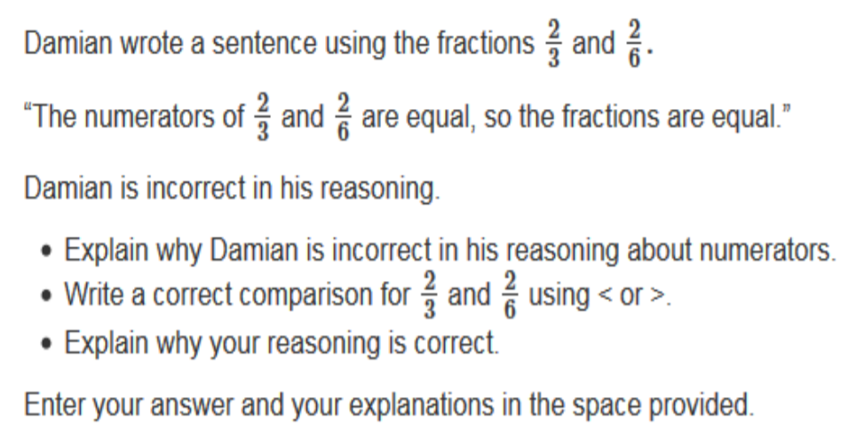

Slide 3

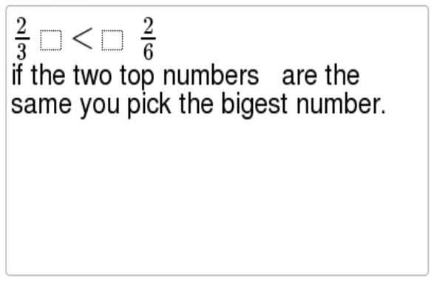
No Points
Joe Pink

Slide 4
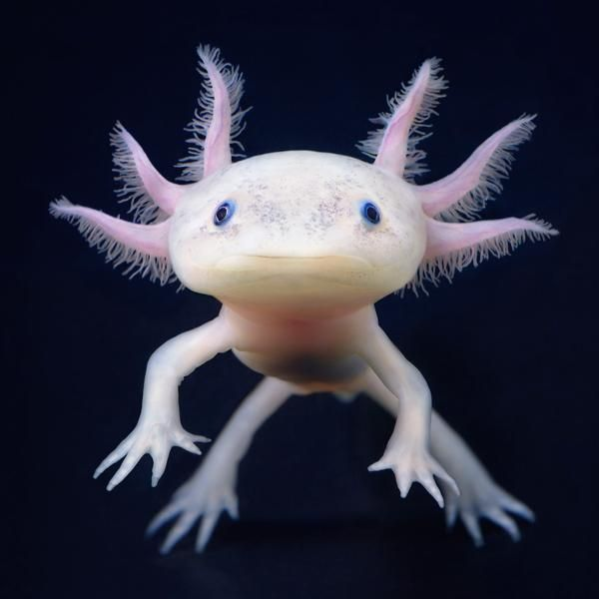

Slide 5
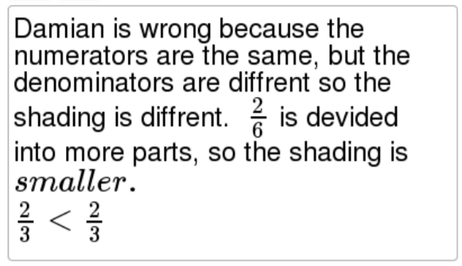
Half Points
Ava Lipsmacker

Slide 6
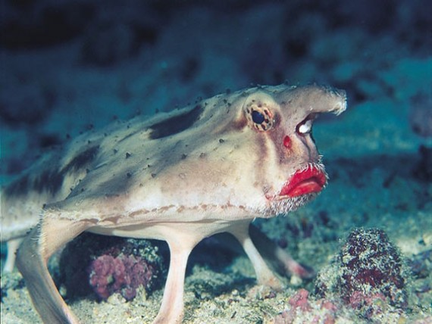

Slide 7
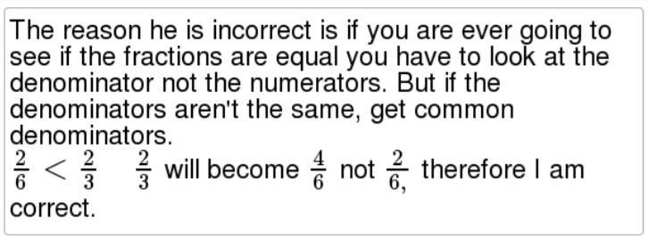
Full Points
Dusty Nurple

Slide 8
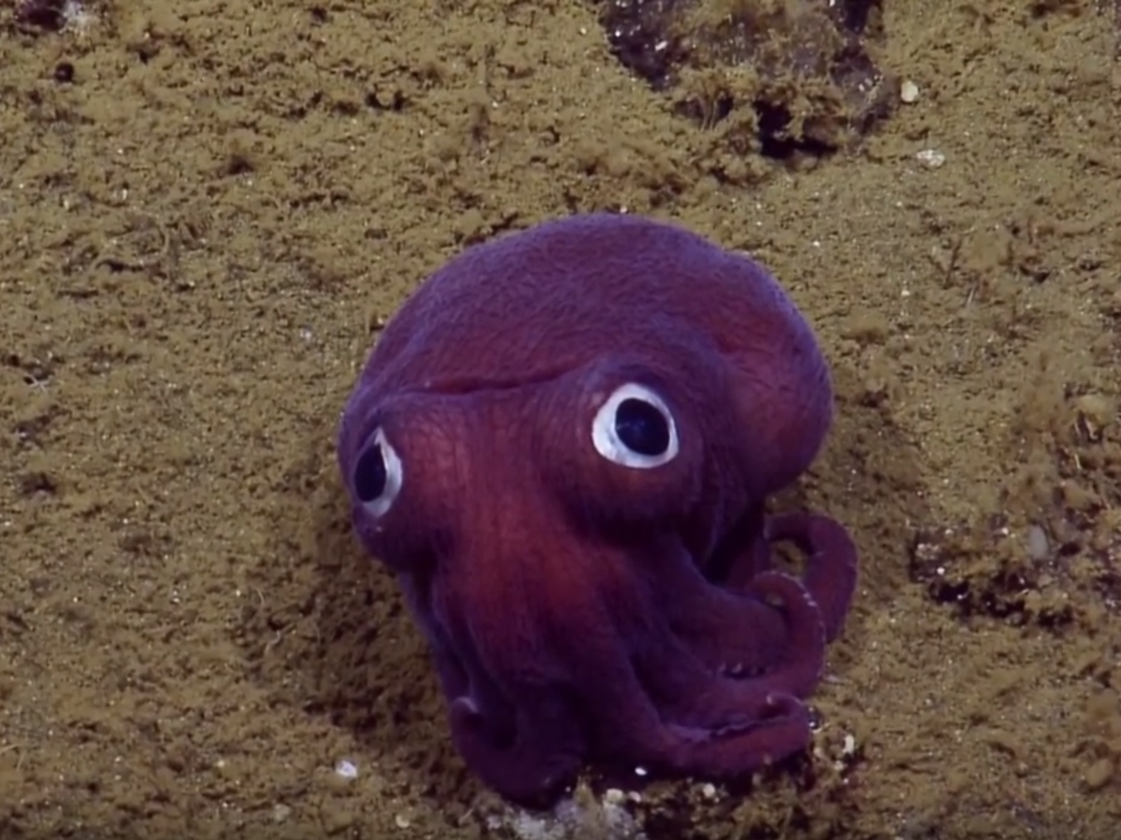

Slide 9
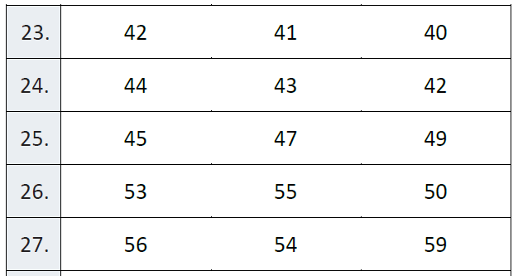
Fluency
Find the prime number

Slide 10
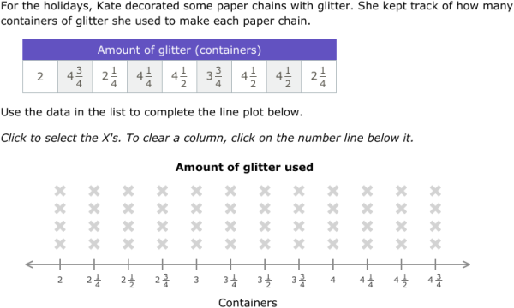
Let’s Look Back!

Slide 11
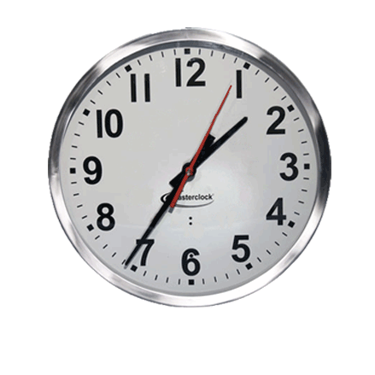
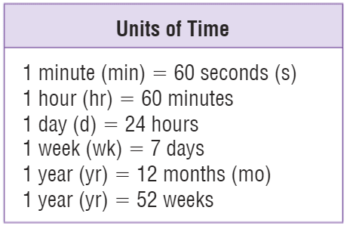
Teach & Reteach
Exactly what time is it?

Slide 12


Teach & Reteach – pg. 691

Slide 13
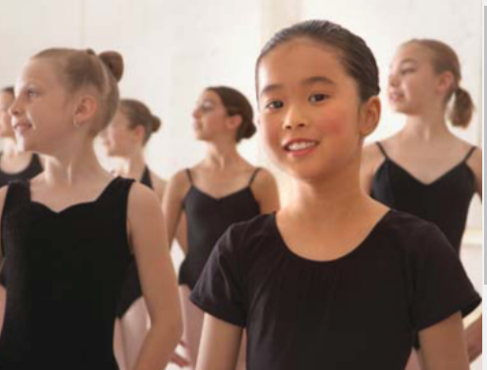
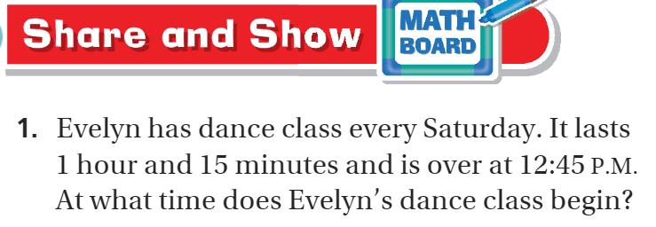

Share and Show pg. 693

Slide 14
I can find elapsed time.
Will you be able to do this?
Yes! | Maybe | No

Slide 15
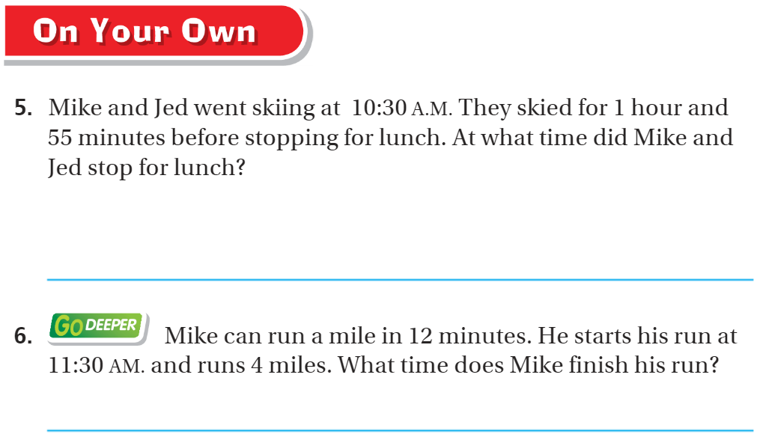
On your own – pg.694

Slide 16
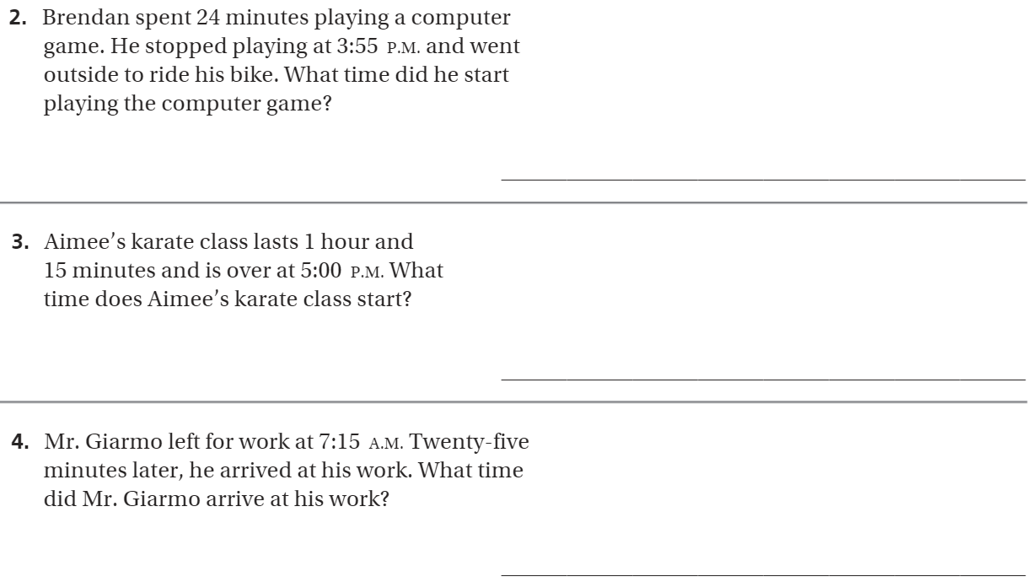
The Friday Quiz – pg. 695

Slide 17
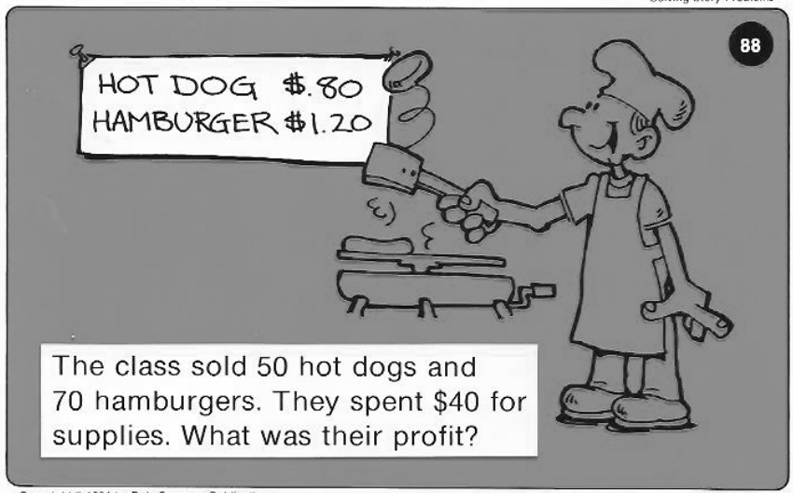
Calculator Problem

Slide 18
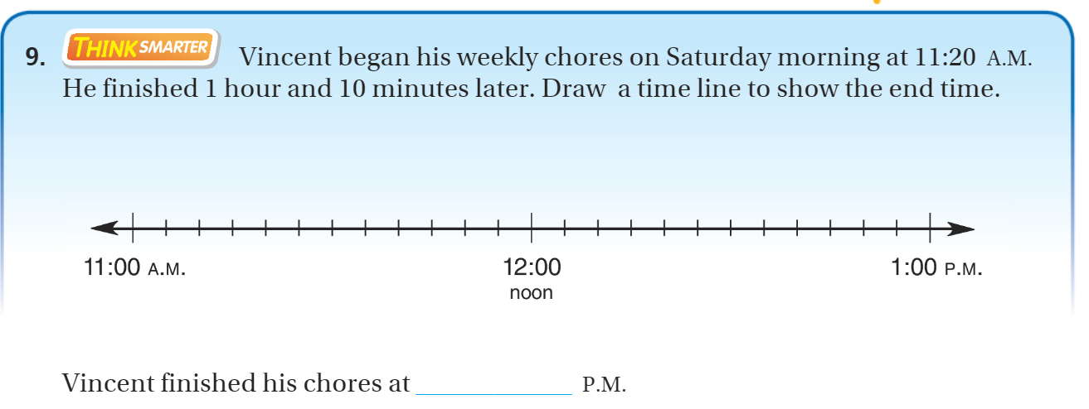
Exit Ticket – pg.694

