Slide 1

Chapter 12
Lesson 12.9

Slide 2

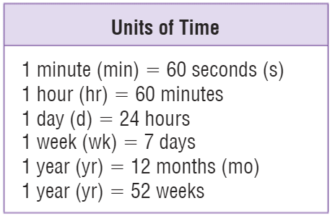
Teach & Reteach
Exactly what time is it?

Slide 3
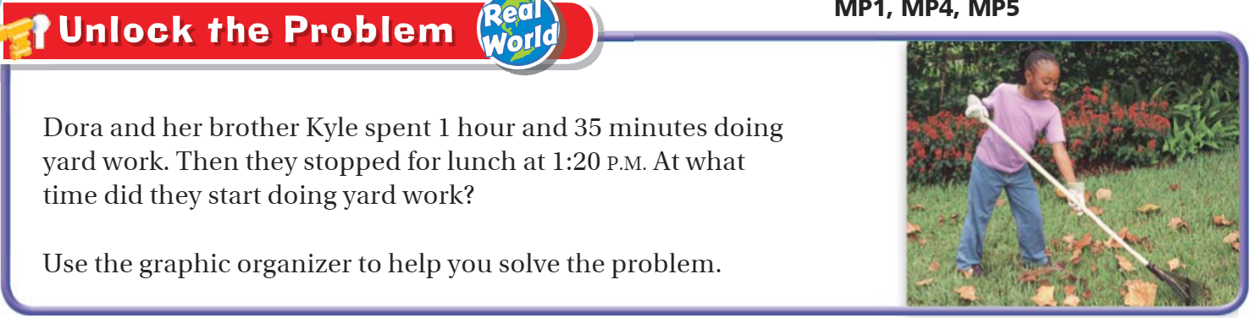
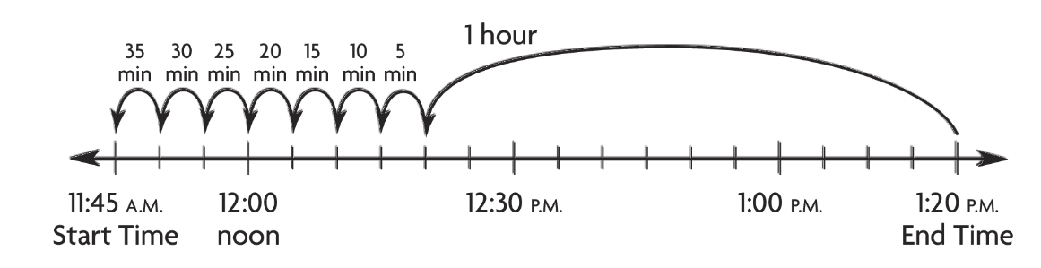
Teach & Reteach – pg. 691

Slide 4

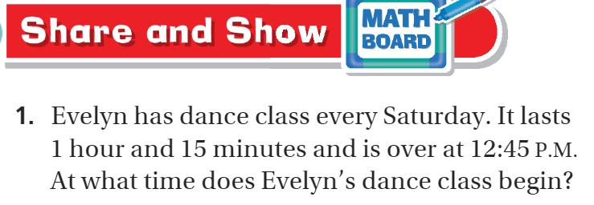
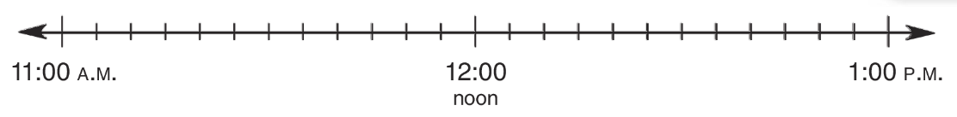
Share and Show pg. 693

Slide 5
I can find elapsed time.
Will you be able to do this?
Yes! | Maybe | No

Slide 6
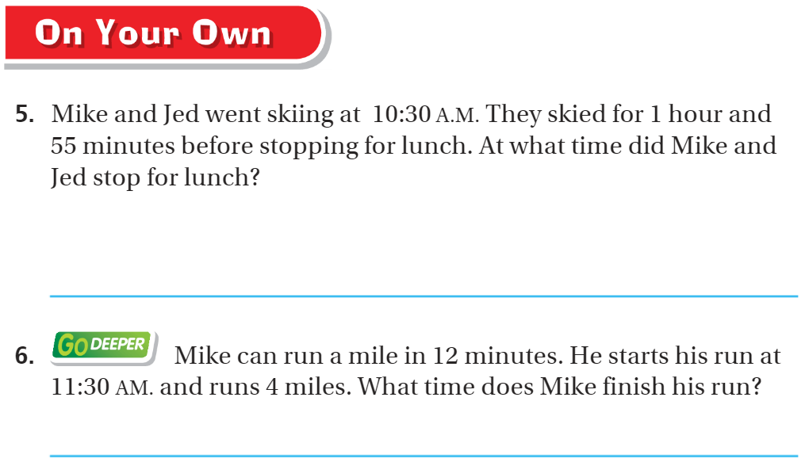
On your own – pg.694

Slide 7
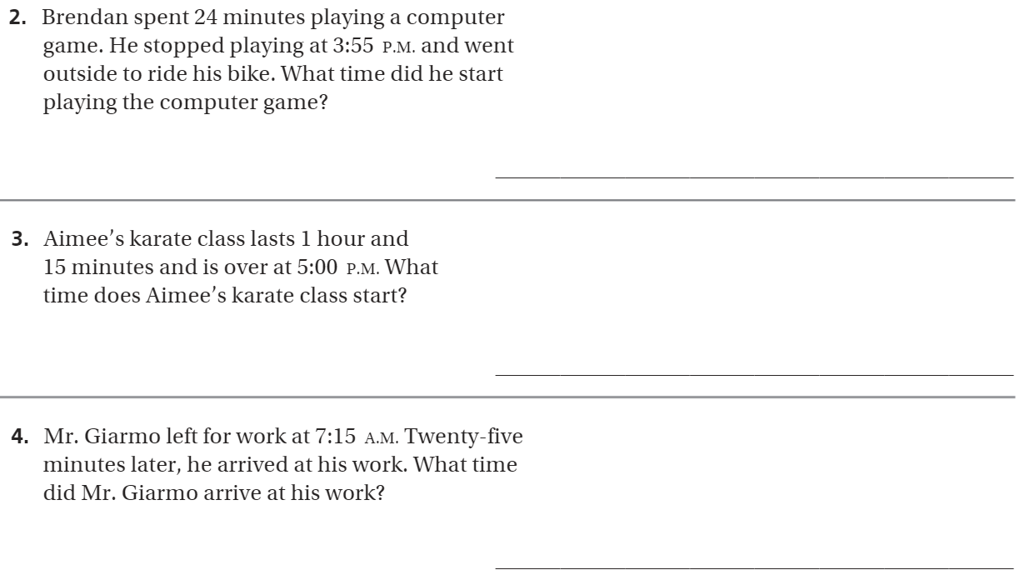
The Friday Quiz – pg. 695

Slide 8
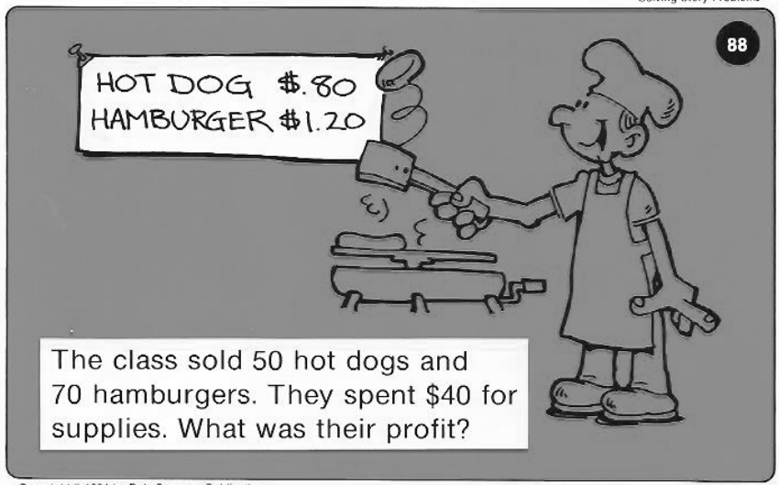
Calculator Problem

Slide 9
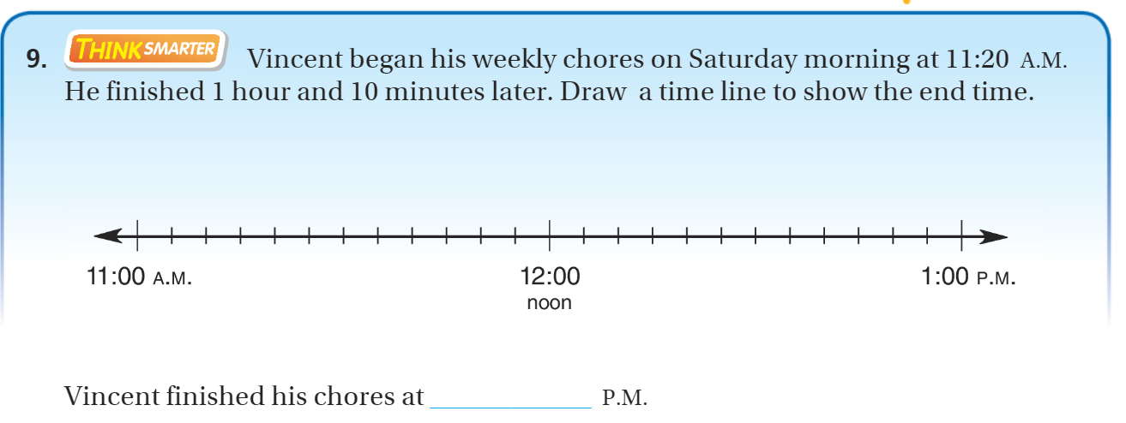
Exit Ticket – pg.694

