Slide 1

Chapter 13
Lesson 13.2

Slide 2

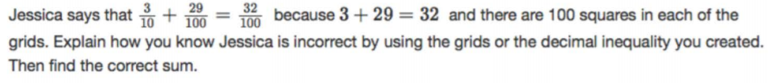
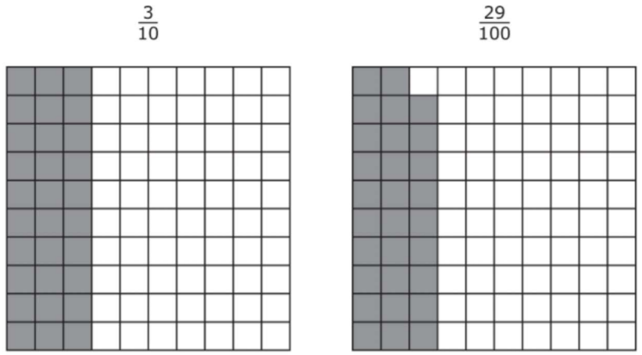

Slide 3

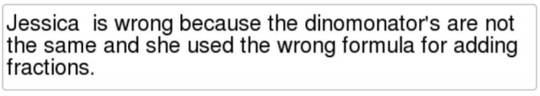
No Points

Slide 4
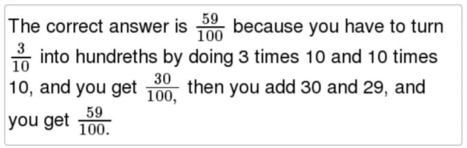
Half Points

Slide 5
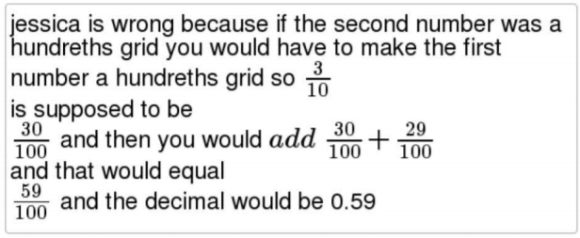
Full Points

Slide 6
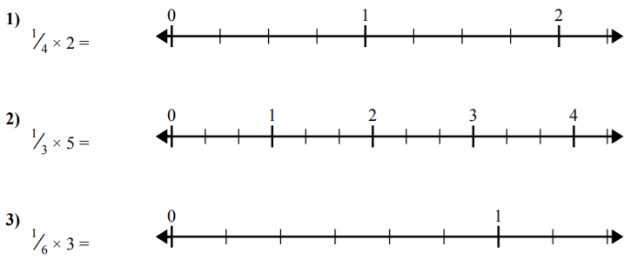
Fluency

Slide 7
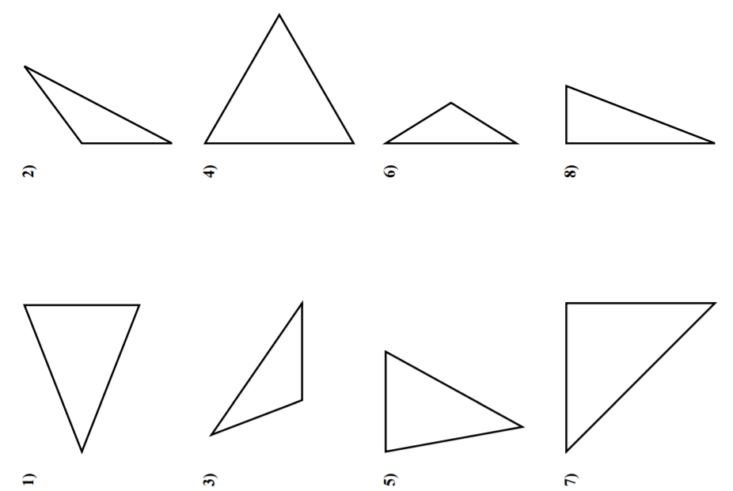
Let’s Look Back!
Name the Triangle

Slide 8
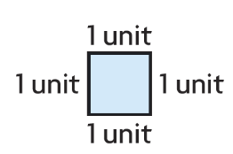

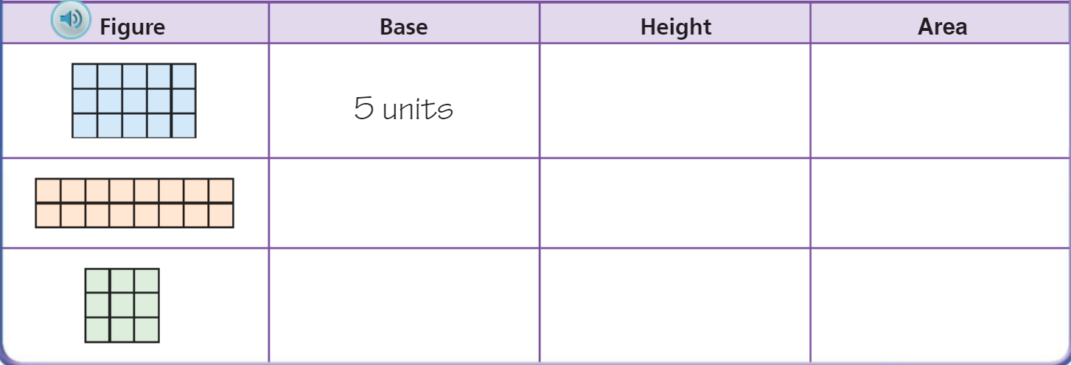
Teach and Reteach – pg. 723

Slide 9
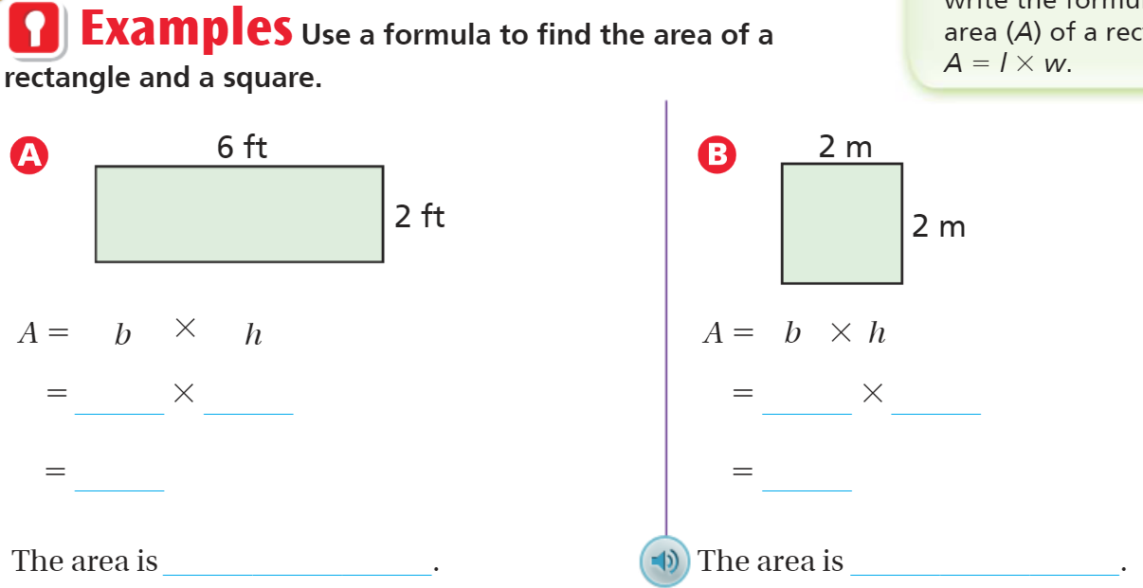
Teach and Reteach – pg.724

Slide 10
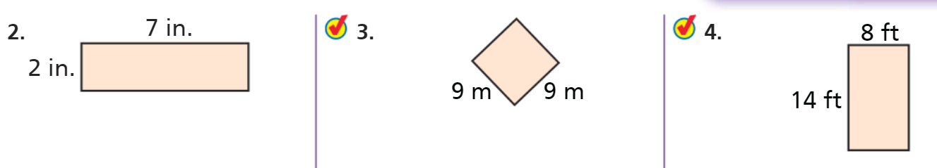
Teach and Reteach – pg.724
Perimeter and Area

Slide 11
I can find the area.
Will you be able to do this?
Yes! | Maybe | No

Slide 12

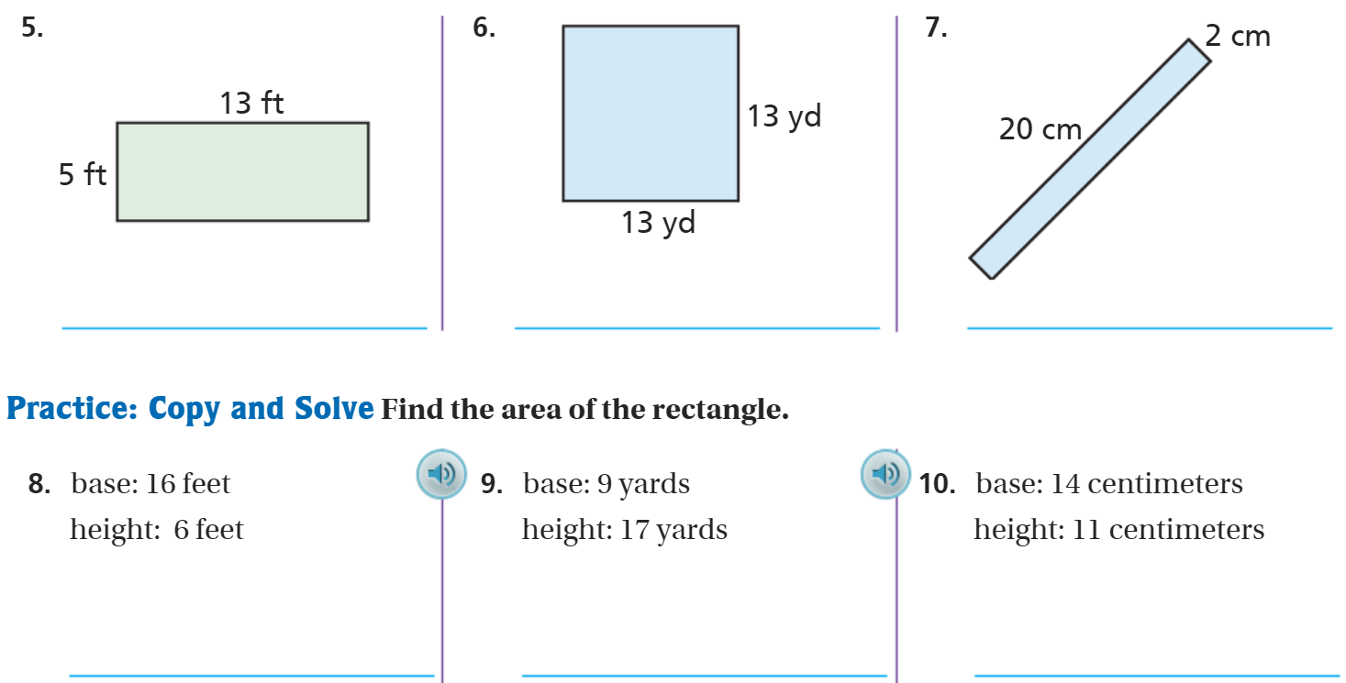
On Your Own – pg.725

Slide 13
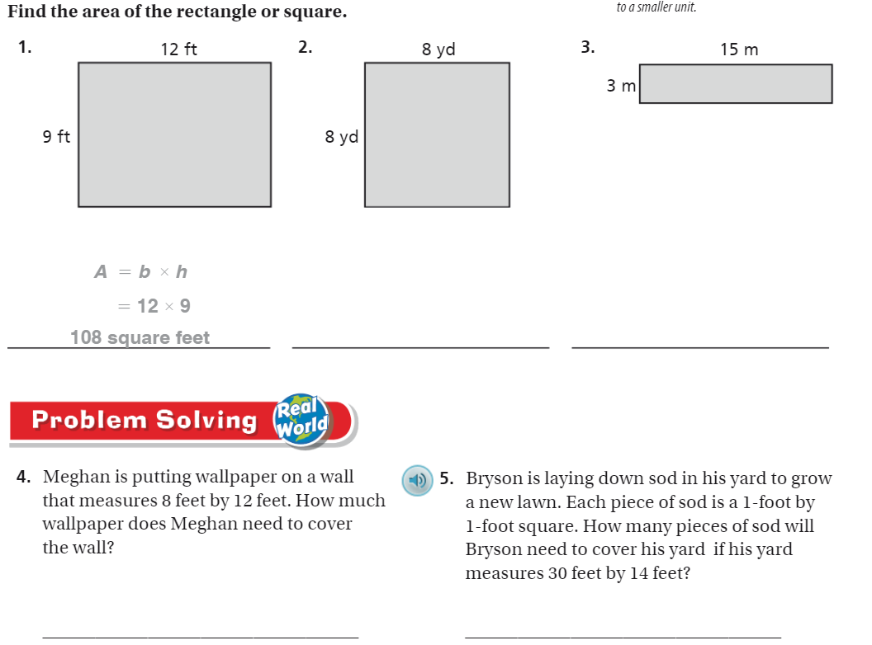
The Friday Quiz – pg. 727

Slide 14
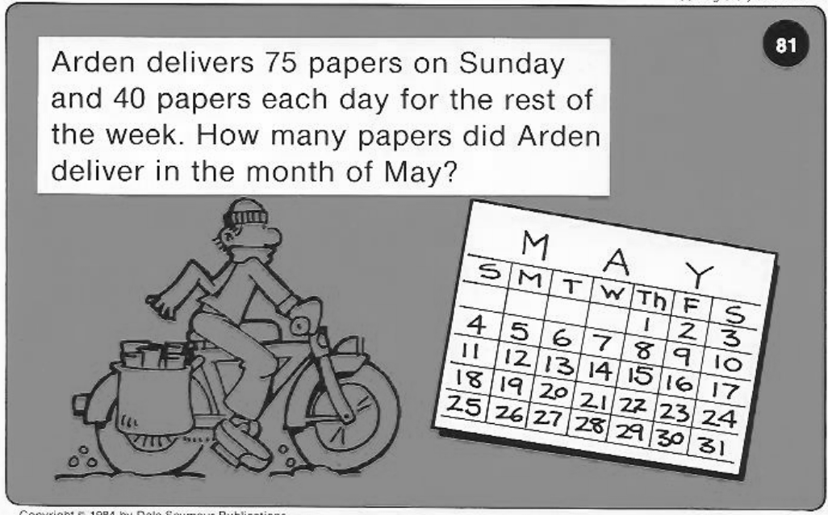
Calculator Problem

Slide 15
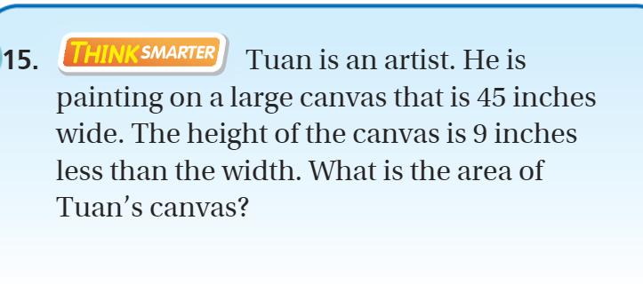
Exit Ticket – pg.726

