Slide 1

Chapter 13
Lesson 13.3

Slide 2

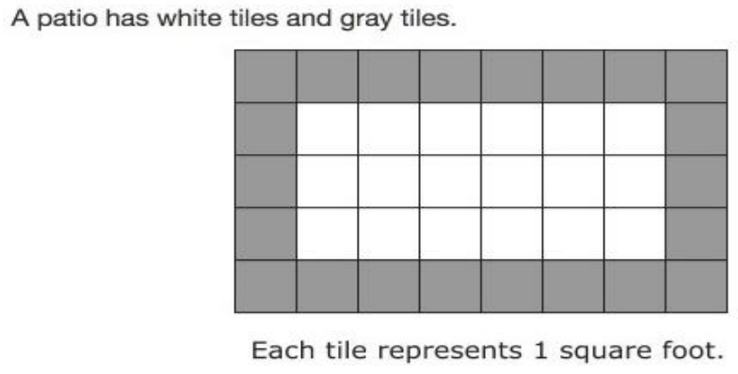


Slide 3


No Points

Slide 4

Half Points

Slide 5
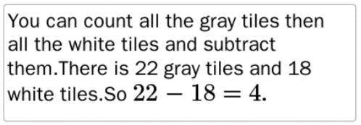
Full Points

Slide 6
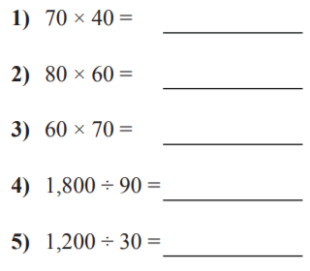
Fluency

Slide 7
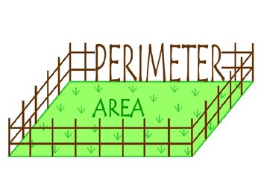
Let’s Look Back!

Slide 8
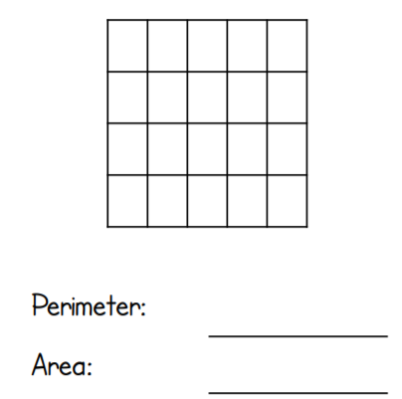
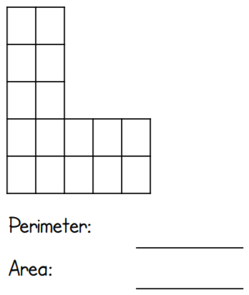
Let’s Look Back!

Slide 9
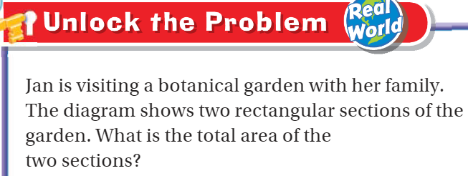
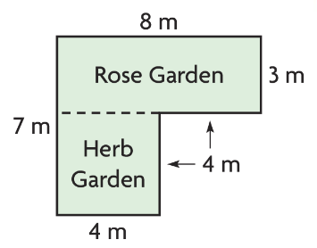
Teach and Reteach – pg.729

Slide 10

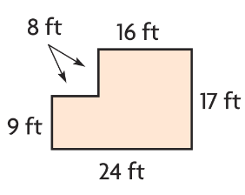
Teach and Reteach – pg. 730

Slide 11
I can find the combined area of a shape.
Will you be able to do this?
Yes! | Maybe | No

Slide 12
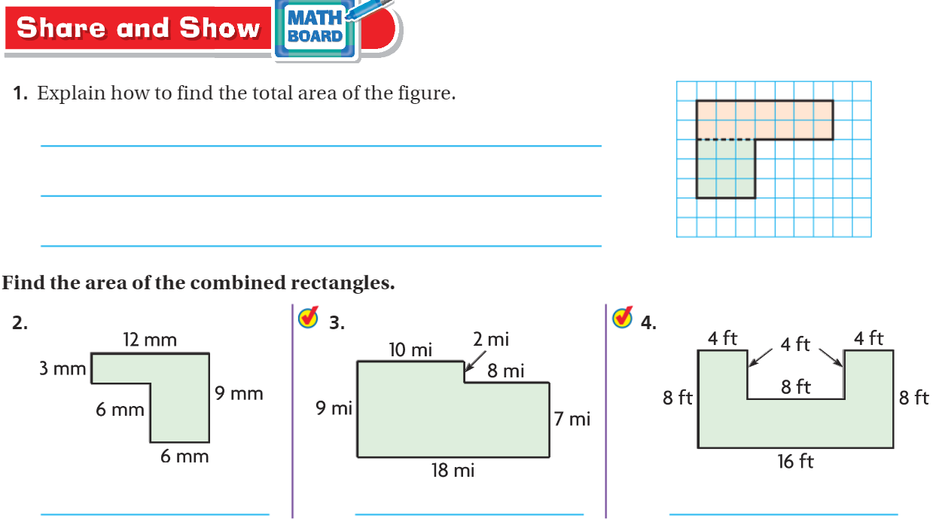
Teach and Reteach – pg. 731

Slide 13
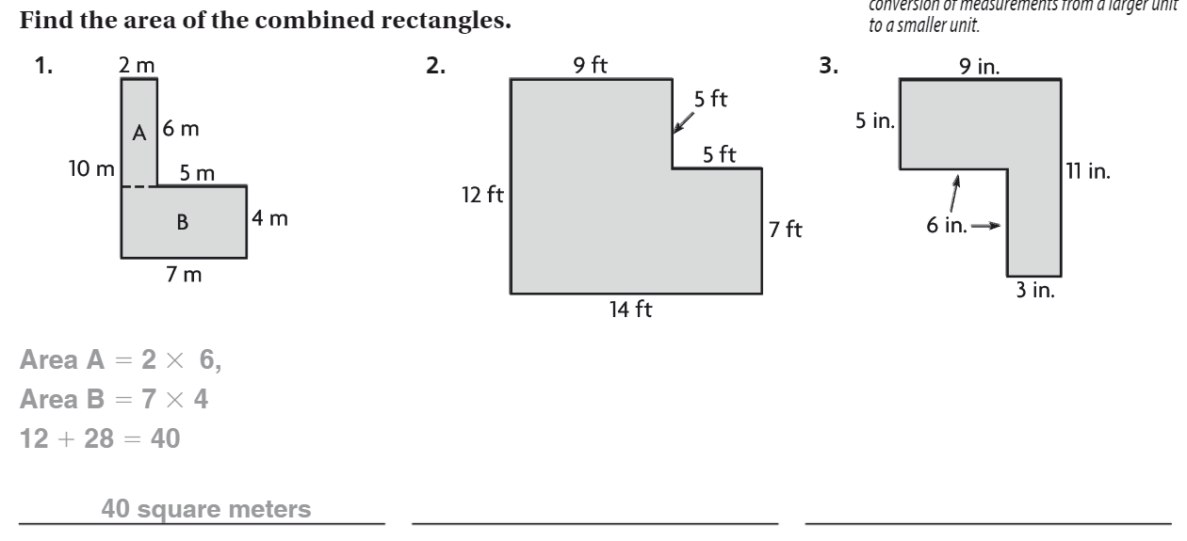
The Friday Quiz – pg. 733

Slide 14
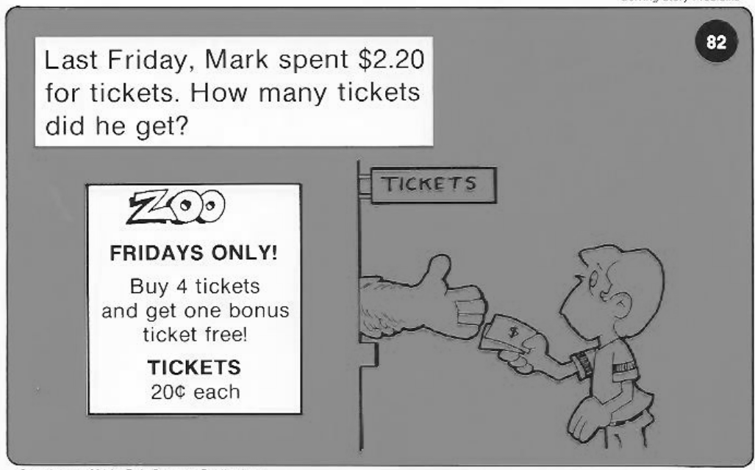
Calculator Problem

Slide 15
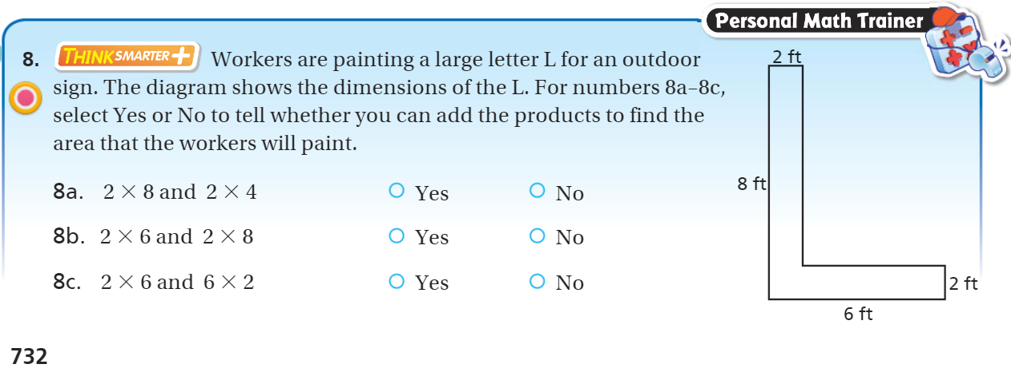
Exit Ticket – pg. 732

