Slide 1

Chapter 13
Lesson 13.4

Slide 2

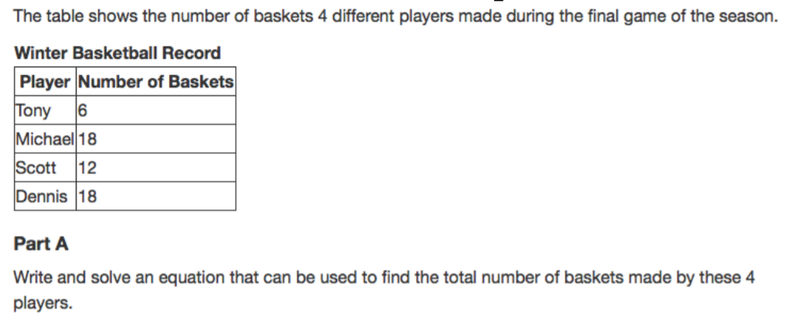

Slide 3

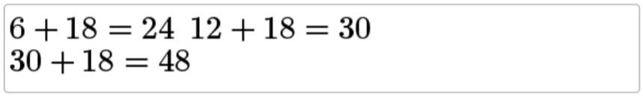
No Points

Slide 4
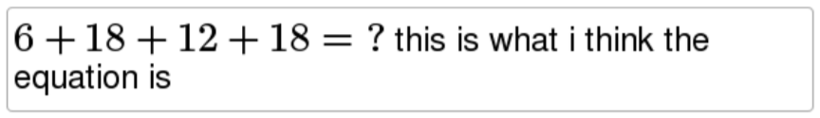
Half Points

Slide 5

Full Points

Slide 6
Fluency
List the factors of 12
List the multiples of 12

Slide 7
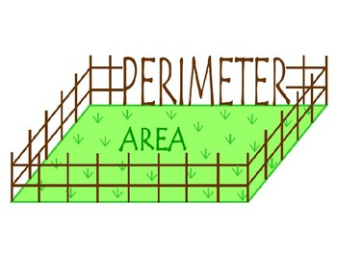
Let’s Look Back!

Slide 8
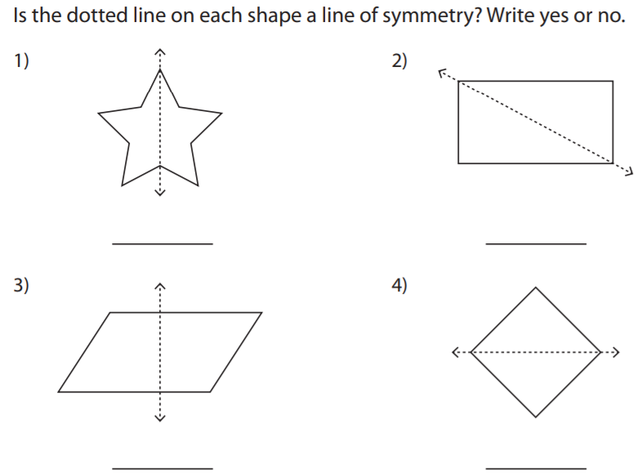
Let’s Look Back!

Slide 9
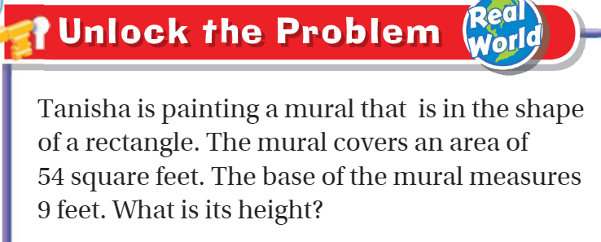
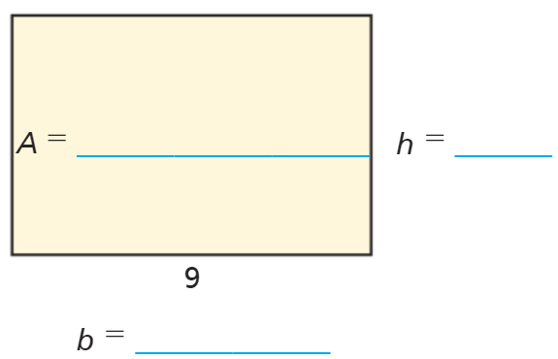
Teach and Reteach – pg. 737

Slide 10
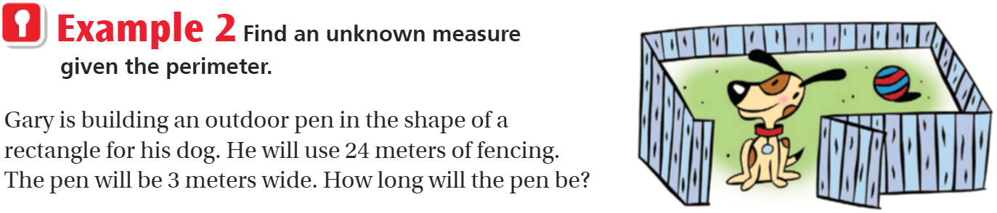
Teach and Reteach – pg.738

Slide 11
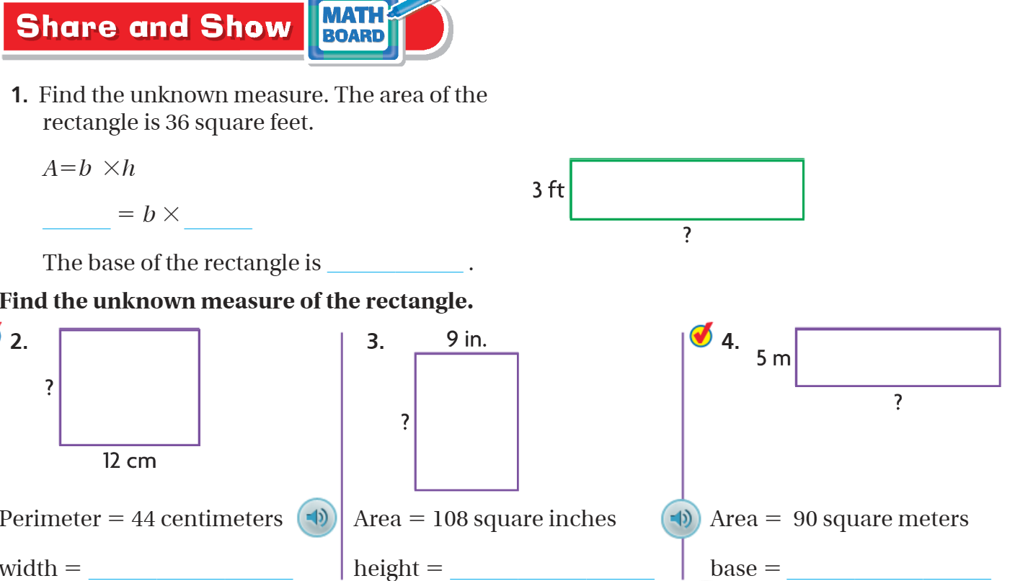

Slide 12
I can find missing dimensions.
Will you be able to do this?
Yes! | Maybe | No

Slide 13
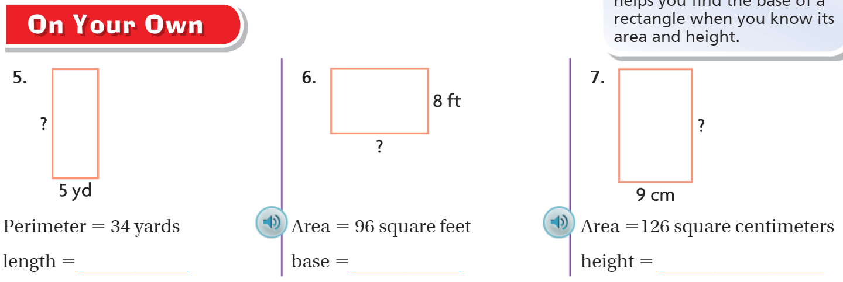
On your own – pg. 739

Slide 14
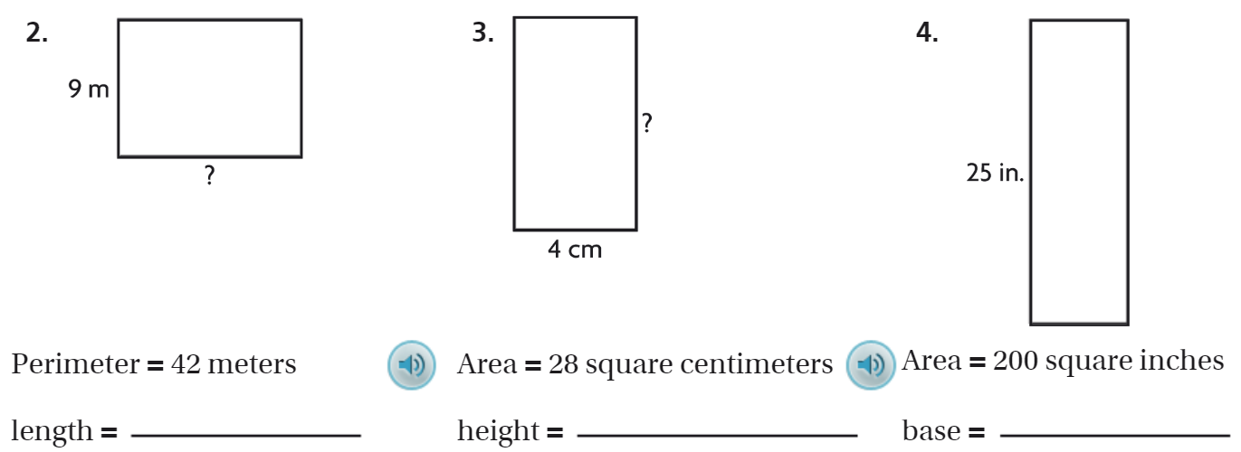
The Friday Quiz – pg. 741

Slide 15
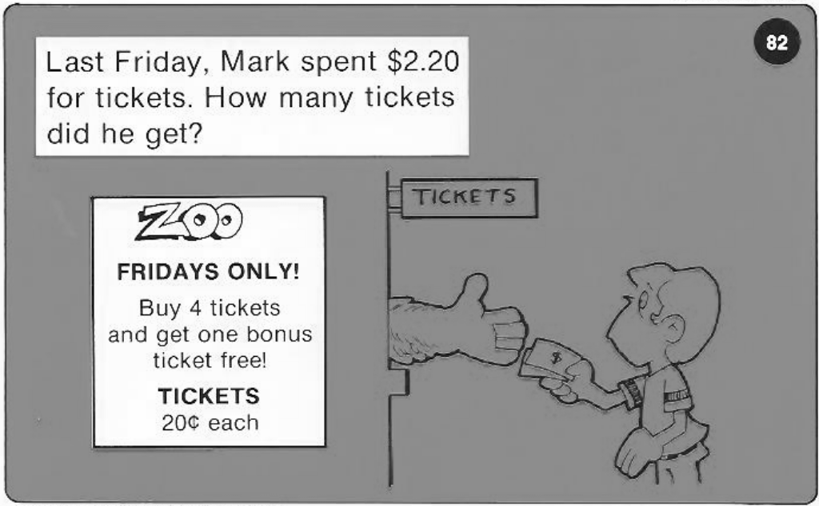
Calculator Problem

Slide 16
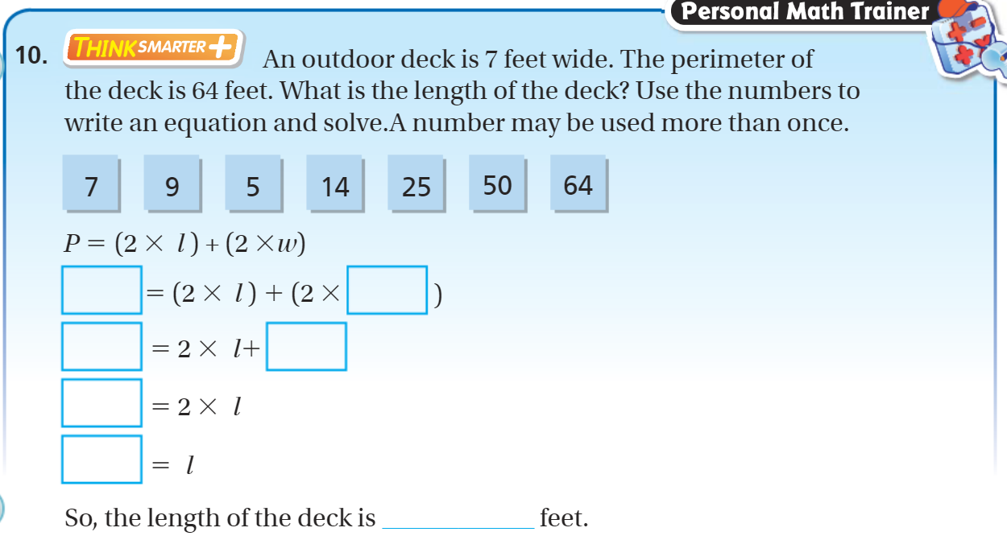
Exit Ticket – pg. 740

