Slide 1

Chapter 13
Lesson 13.5

Slide 2
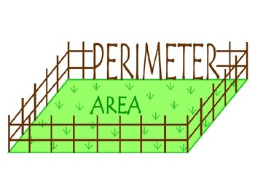
Let’s Look Back!

Slide 3

Teach and Reteach – pg.738

Slide 4
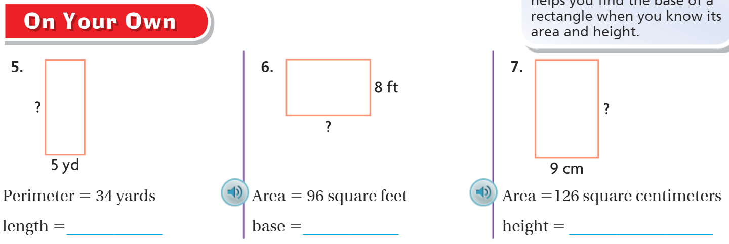
On your own – pg. 739

Slide 5

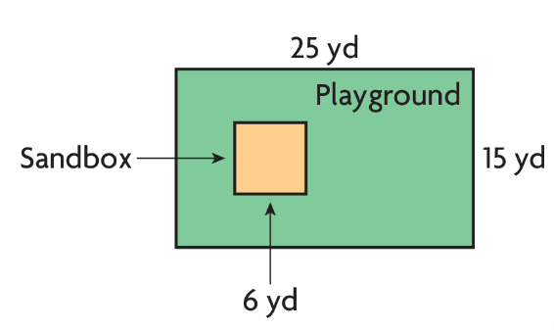

Slide 6

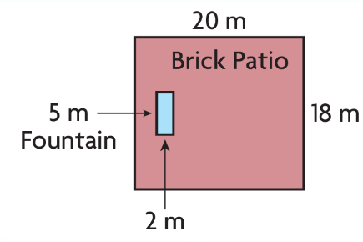

Slide 7

