Slide 1
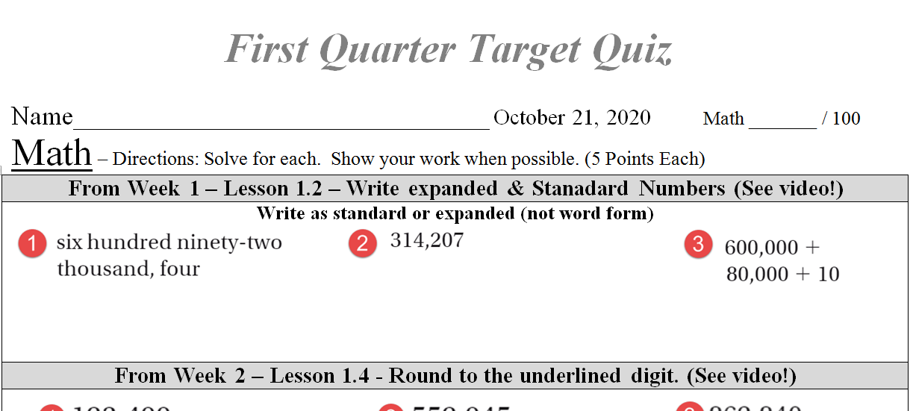
Review

Slide 2

Quarter Review

Slide 3

Quarter Review

Slide 4

Quarter Review

Slide 5

Quarter Review

Slide 6

Quarter Review

Slide 7

Quarter Review

Slide 8
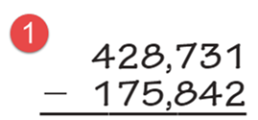
Quarter Review

Slide 9
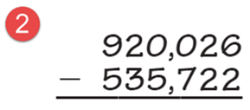
Quarter Review

Slide 10
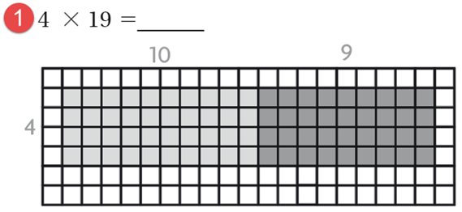
Quarter Review

Slide 11
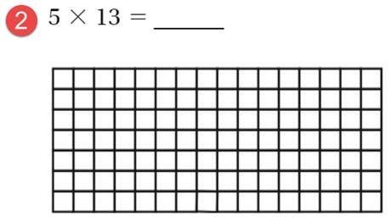
Quarter Review

Slide 12
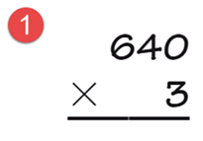
Quarter Review

Slide 13
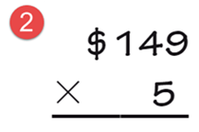
Quarter Review

Slide 14

Quarter Review

Slide 15

Quarter Review

Slide 16
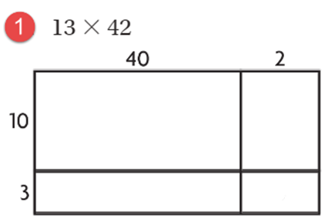
Quarter Review

Slide 17

Quarter Review

Slide 18
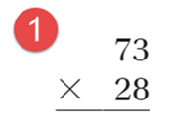
Quarter Review

Slide 19
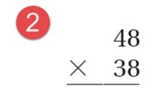
Quarter Review

Slide 20
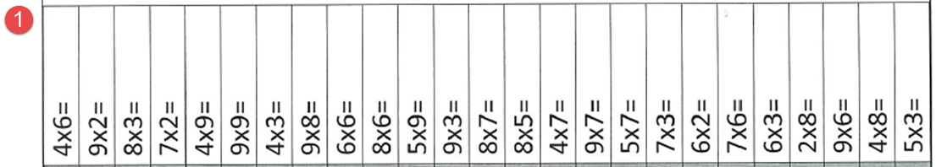
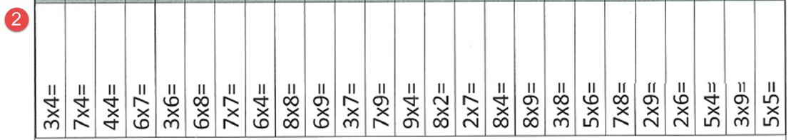
Quarter Review

