Slide 1

Fraction Fluency

Slide 2
Improper Fractions & Mixed Numbers

Slide 3

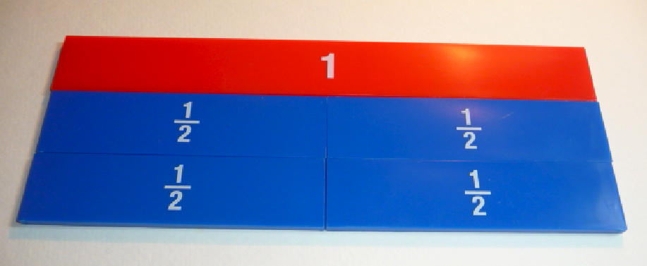

Slide 4



Slide 5



Slide 6

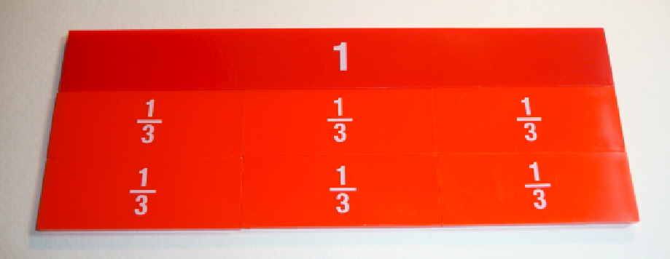

Slide 7

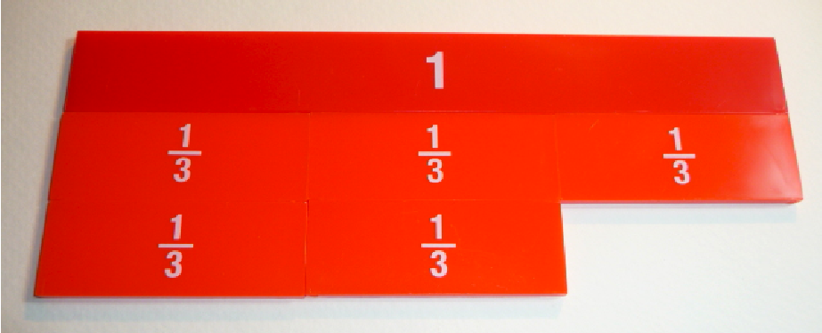

Slide 8

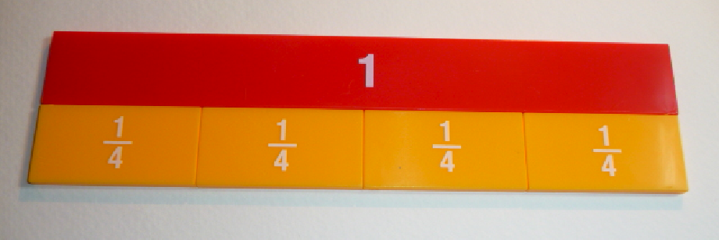

Slide 9



Slide 10



Slide 11



Slide 12



Slide 13



Slide 14

