Slide 1

Chapter 8
Lesson 8.3

Slide 2
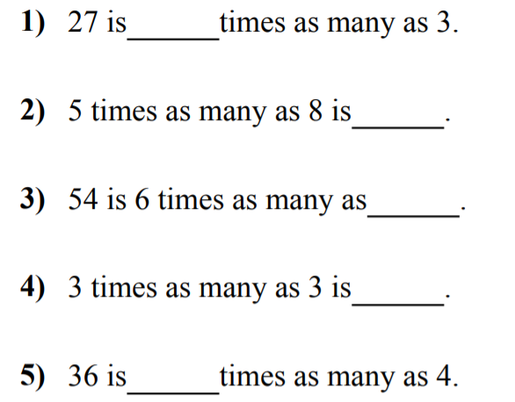
Fluency

Slide 3
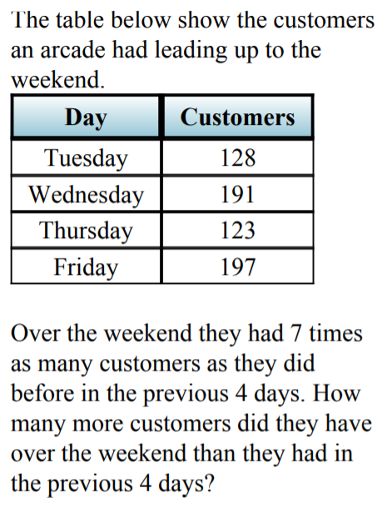
Math Journal

Slide 4

Math Journal

Slide 5
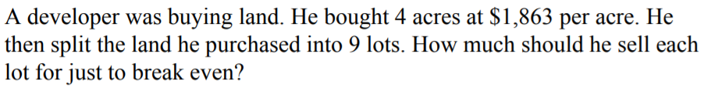
Math Journal

Slide 6
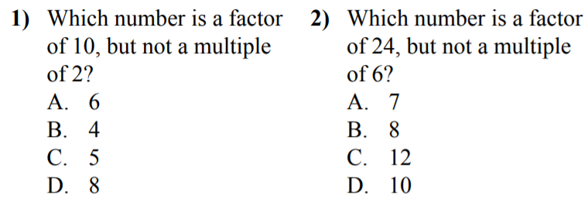
Math Journal
Explain your reasoning

Slide 7
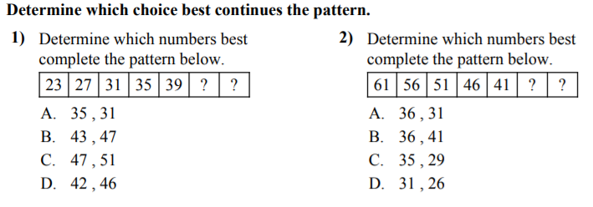
Math Journal

Slide 8
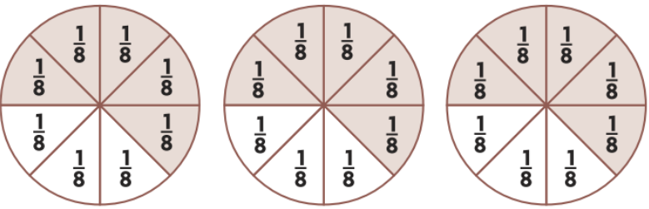
Write an Equation

Slide 9
I can make Equivalent Fractions
Will you be able to do this?
Yes! | Maybe | No

Slide 10
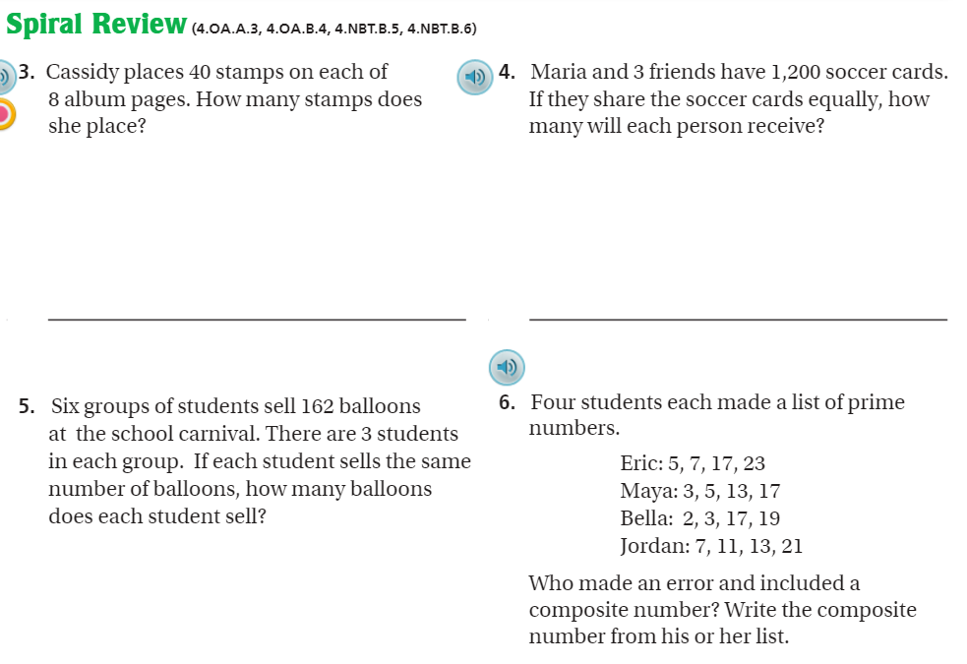
Spiral review- Pg. 332

Slide 11
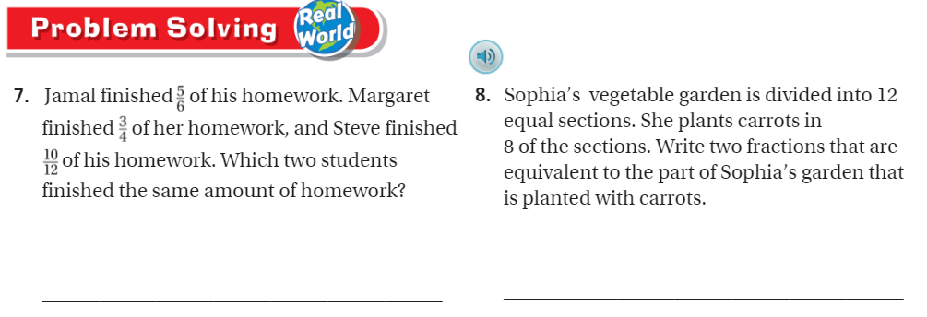
Problem Solving Pg. 331

Slide 12
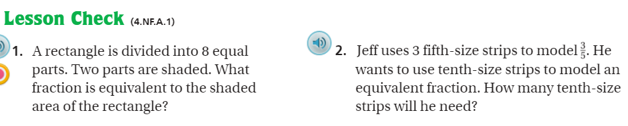
Lesson Check Pg. 332

Slide 13
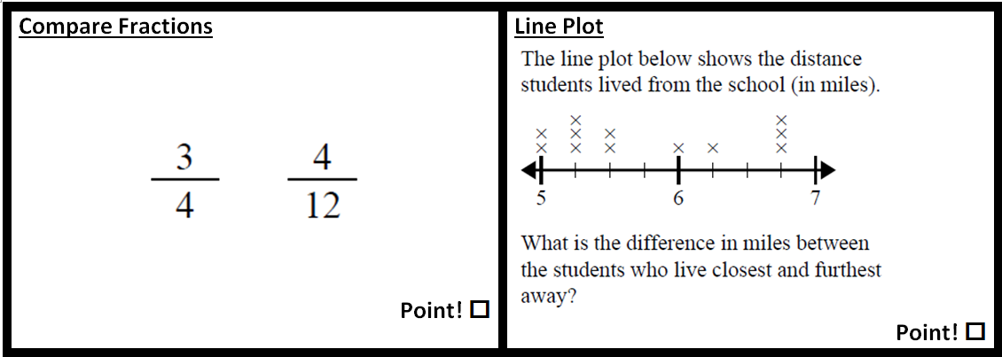
The Friday Quiz

Slide 14
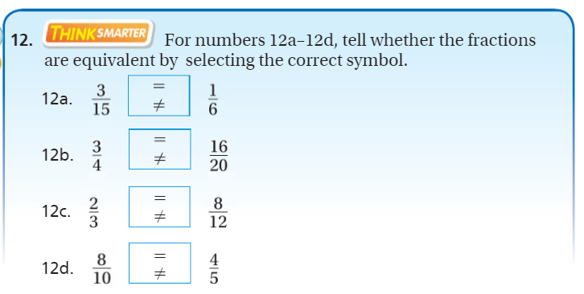
Exit Ticket – pg. 330

