Slide 1

Chapter 6
Lesson 6.2 Problem Solving

Slide 2
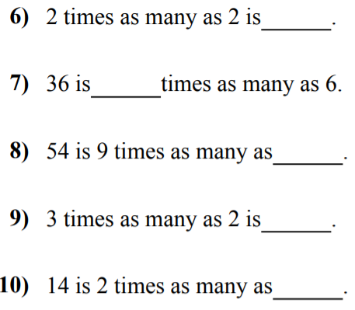

Slide 3


Slide 4
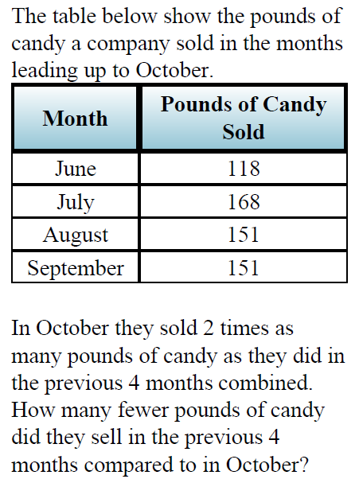

Slide 5
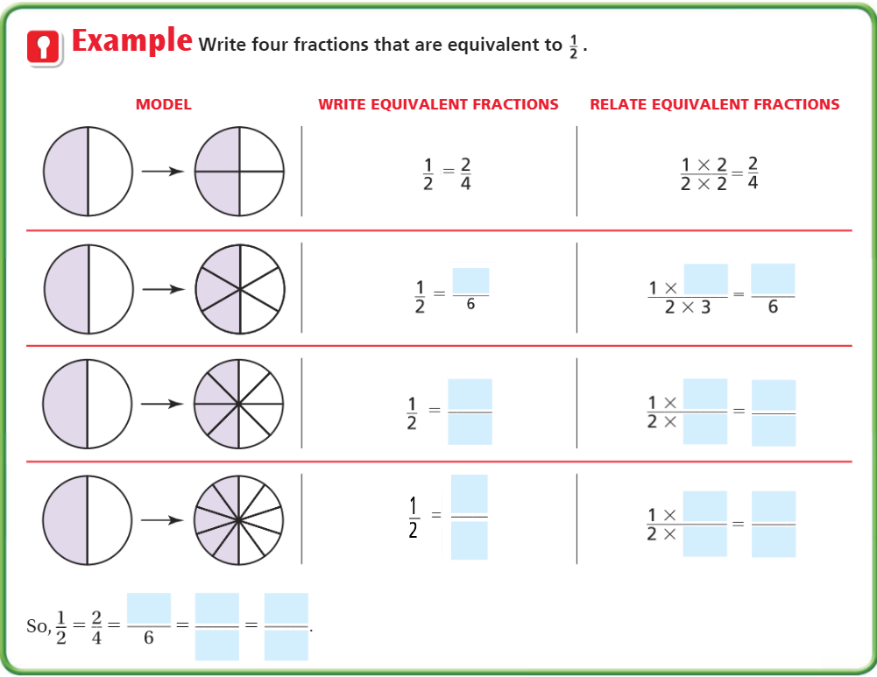
Teach and Reteach – pg. 334

Slide 6
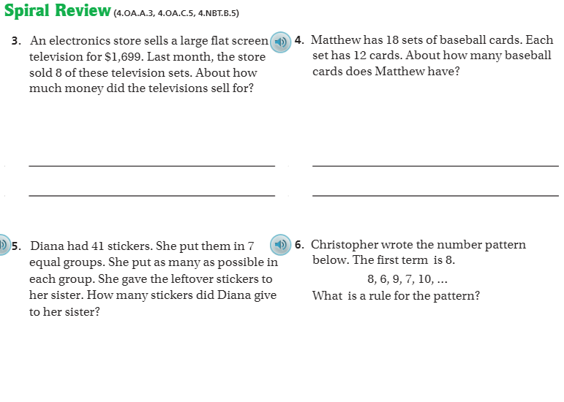
Spiral Review pg. 338

Slide 7
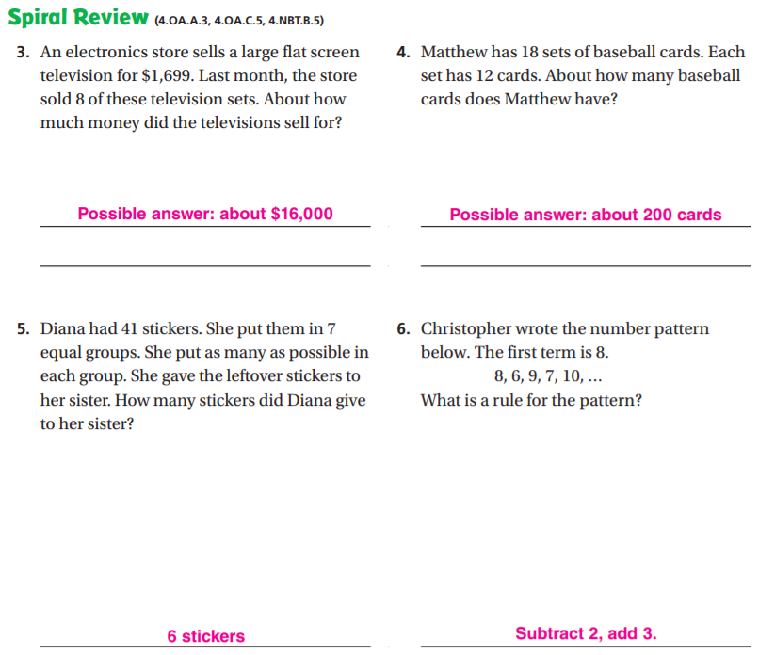

Slide 8
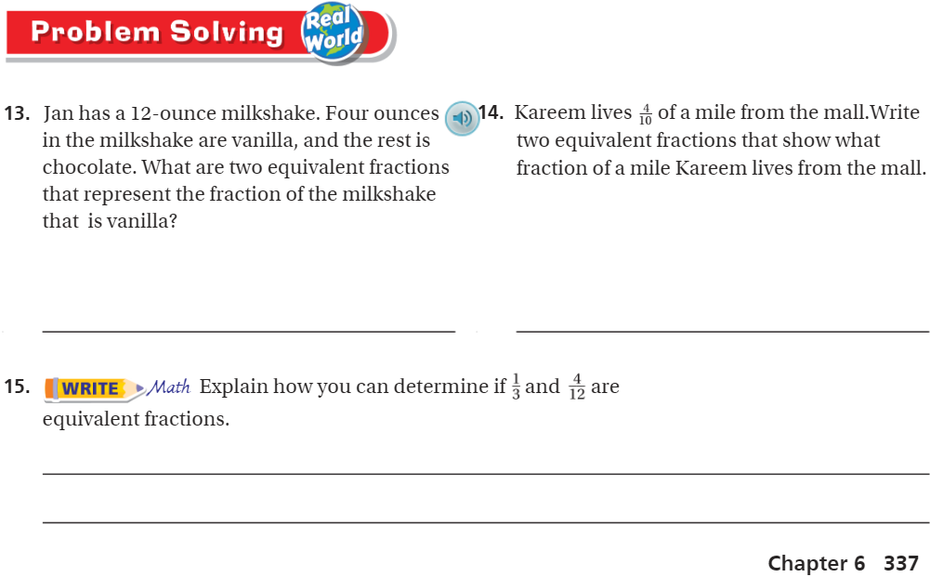
Problem Solving Pg. 337

Slide 9
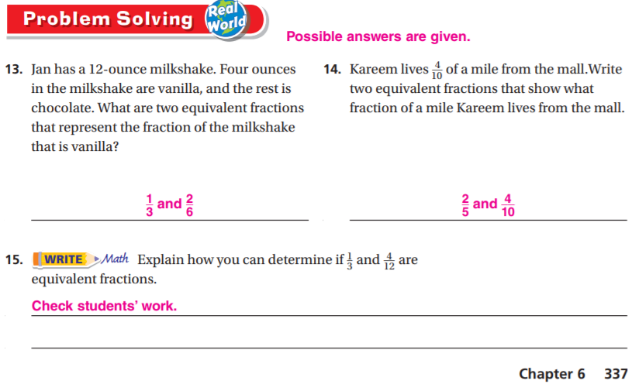

Slide 10

Lesson Check – Pg. 338

Slide 11


Slide 12
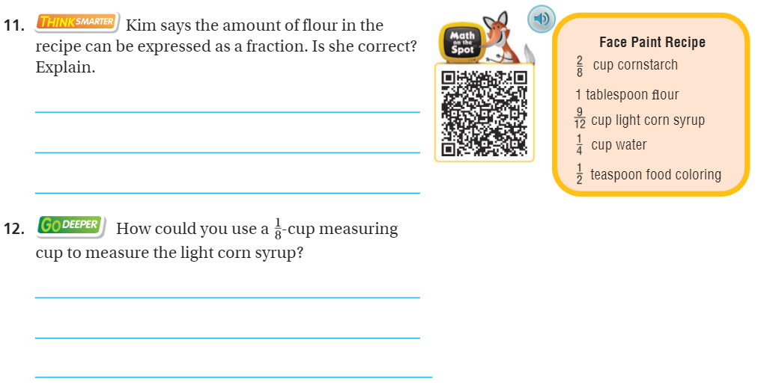
The Friday Quiz – Pg. 336

Slide 13
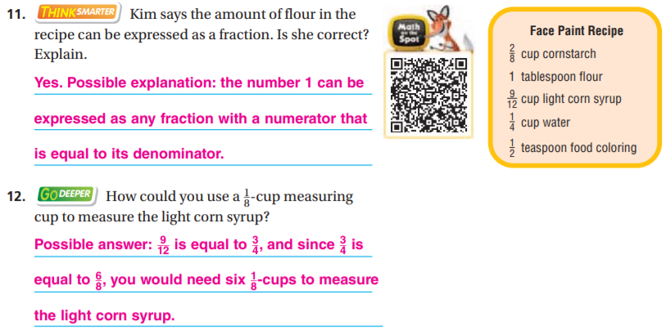

Slide 14
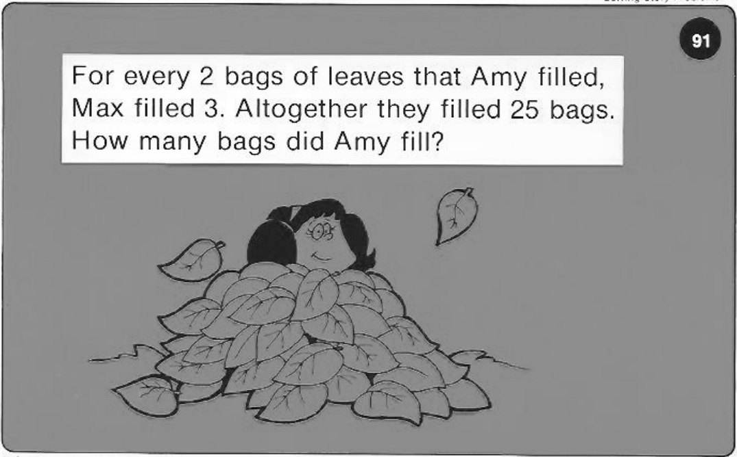
Calculator Problem

Slide 15
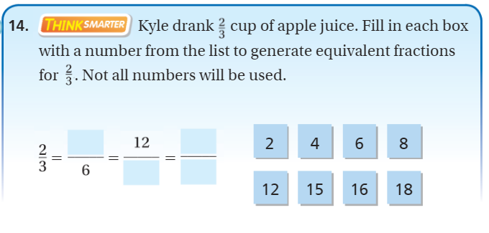
Exit Ticket – pg. 336

