Slide 1

Chapter 6
Lesson 6.3 Problem Solving

Slide 2
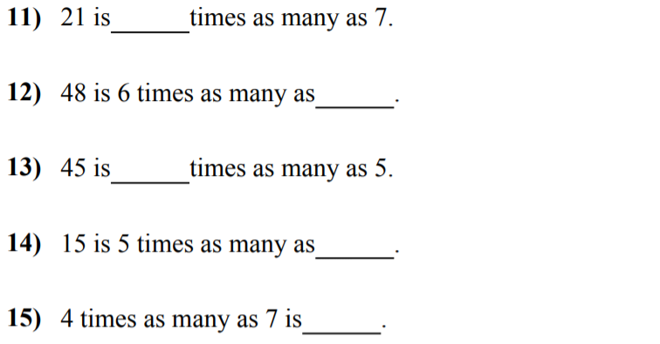

Slide 3
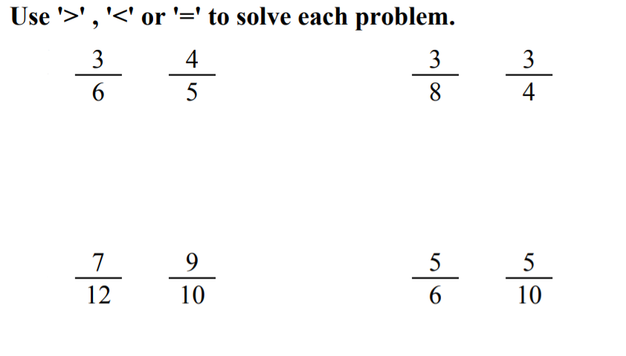

Slide 4
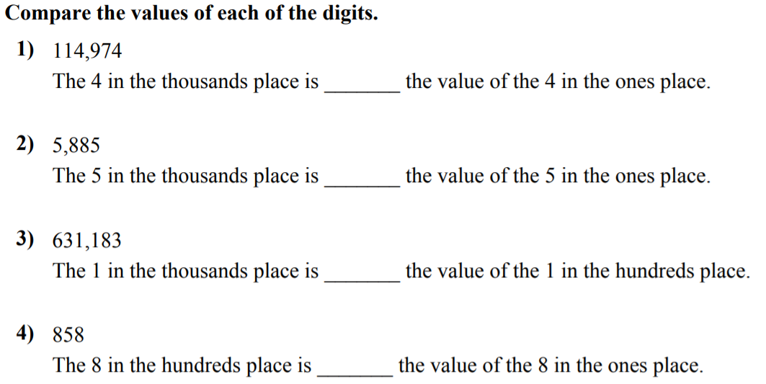

Slide 5
I can make fractions
in simplest form
Will you be able to do this?
Yes! | Maybe | No

Slide 6
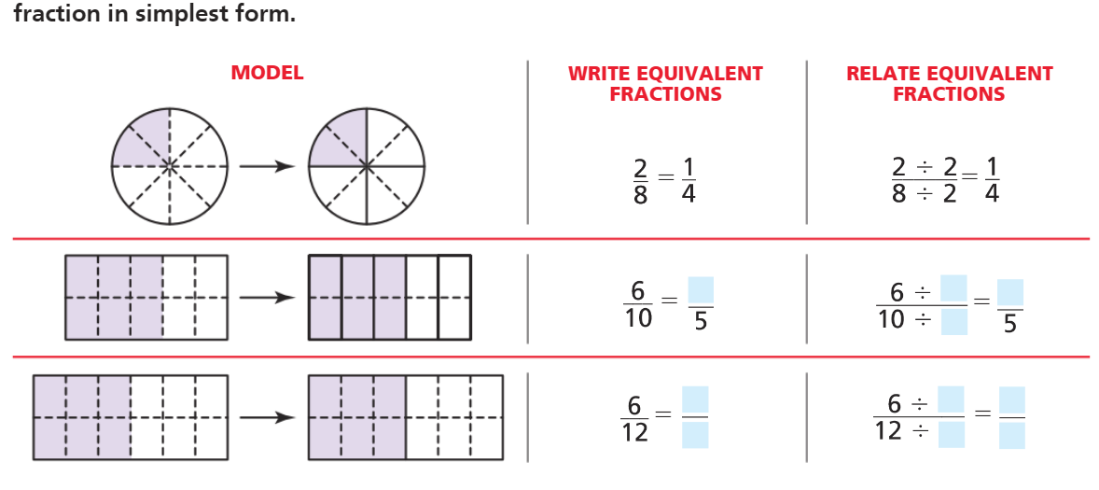
Pg. 340

Slide 7
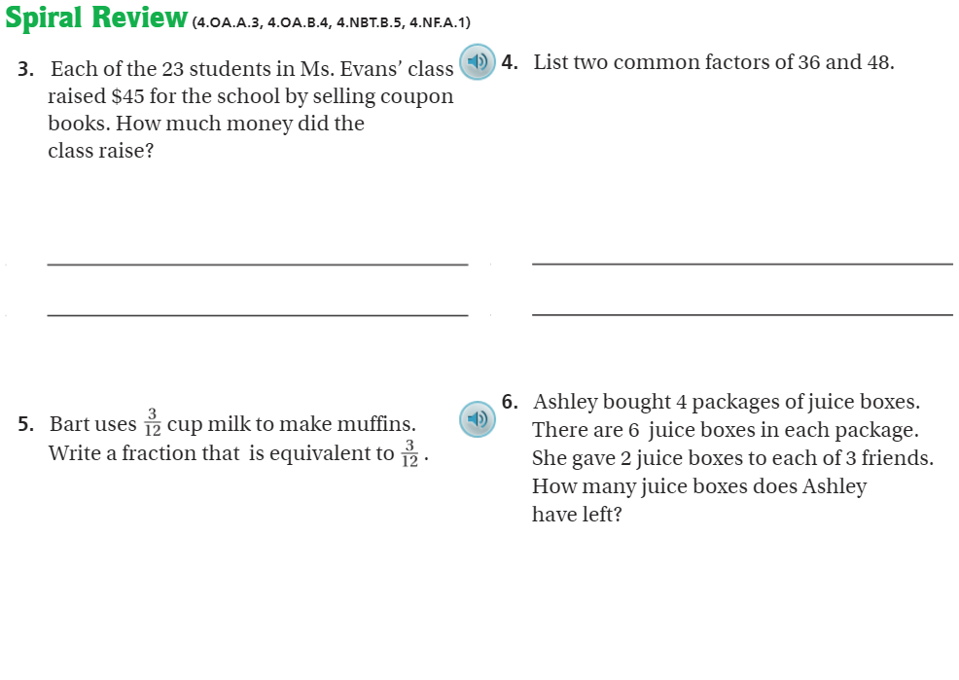
Pg. 344

Slide 8
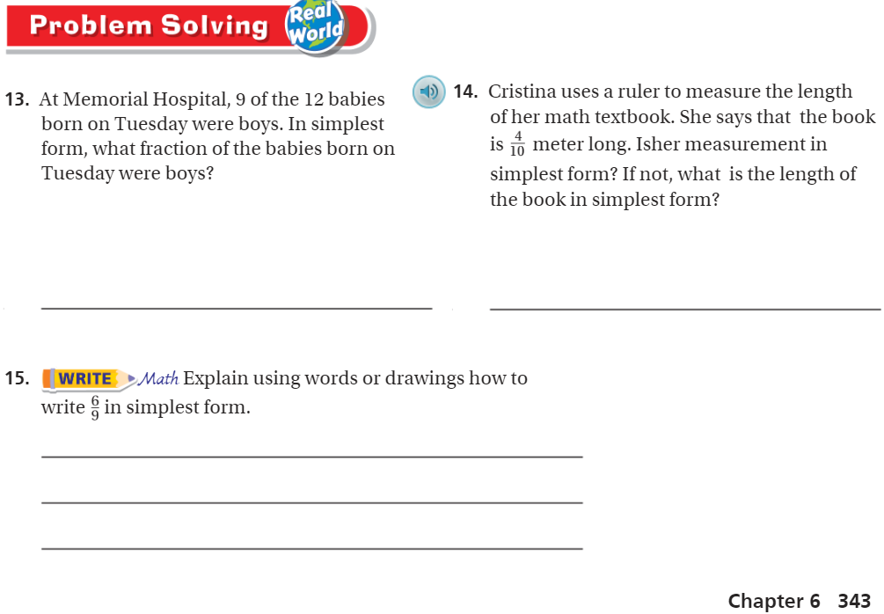
Pg. 343

Slide 9
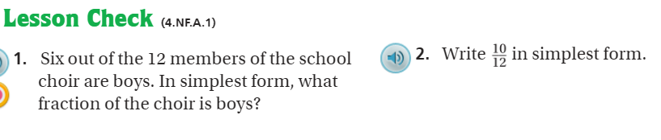
Pg. 344

Slide 10
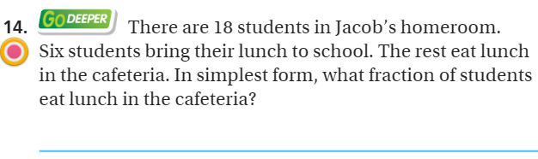
The Friday Quiz – Pg. 341

Slide 11
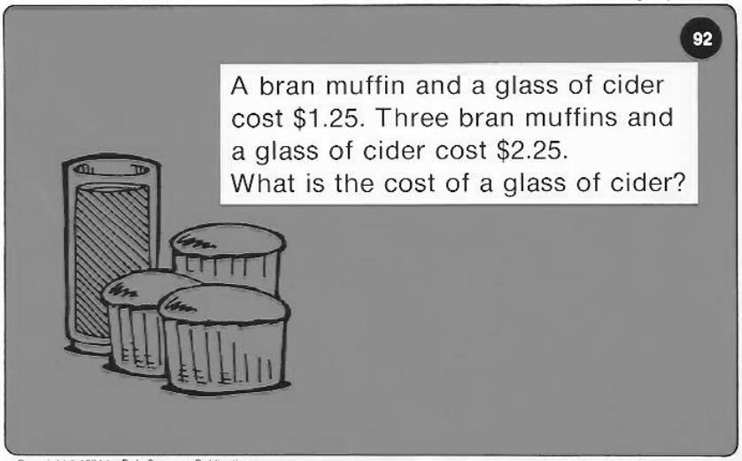
Calculator Problem

Slide 12
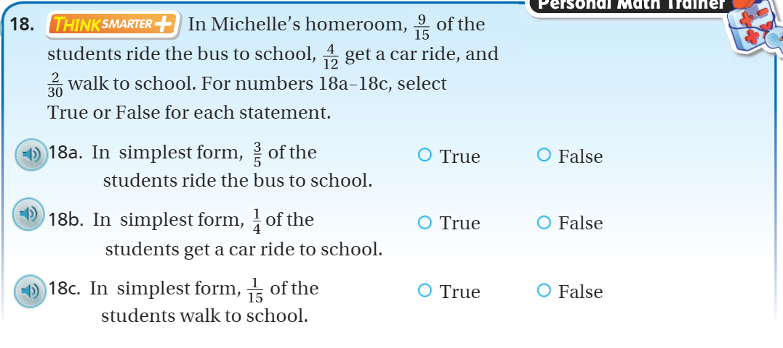
Exit Ticket – pg. 342

