Slide 1

Chapter 6
Lesson 6.5 Problem Solving

Slide 2
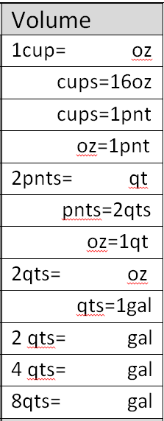
Fluency
Measurement

Slide 3
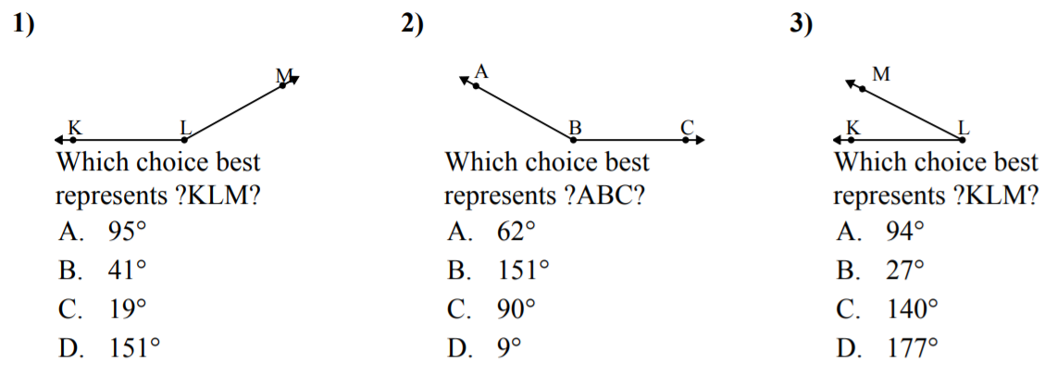
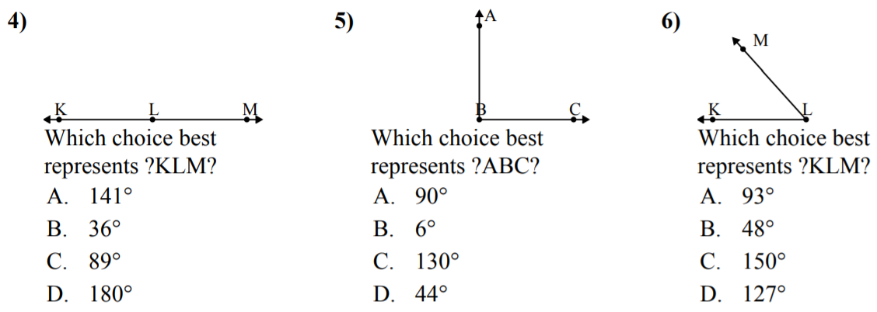

Slide 4
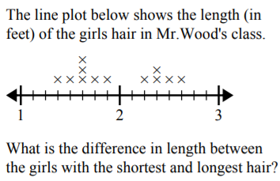

Slide 5
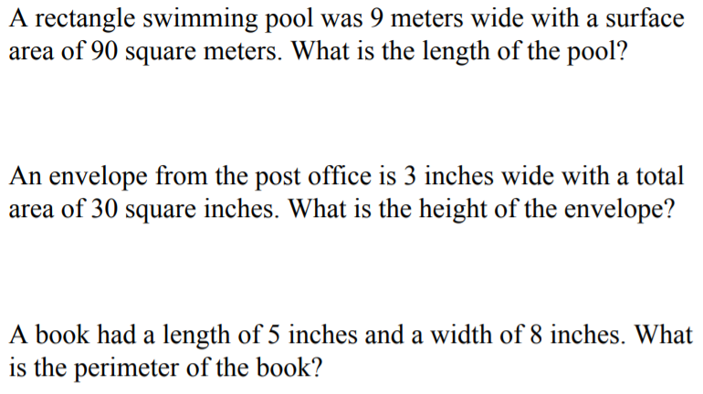

Slide 6
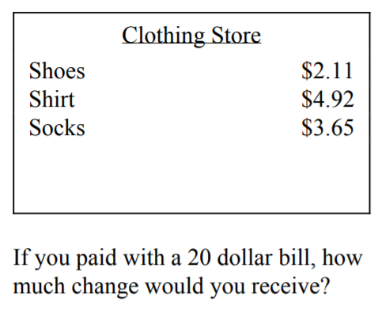

Slide 7
I can find equivalent fractions
Will you be able to do this?
Yes! | Maybe | No

Slide 8
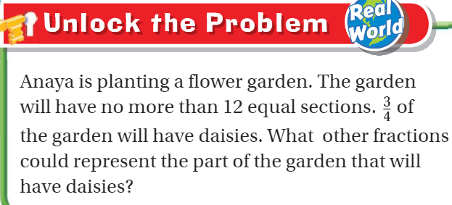
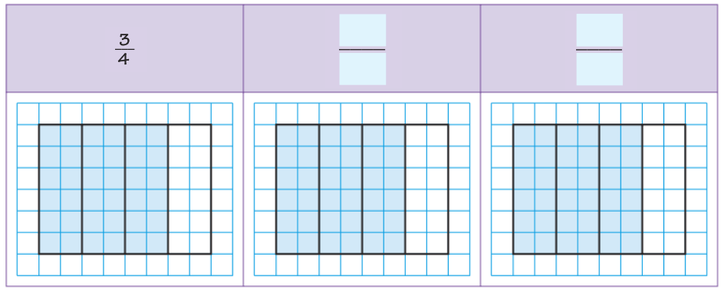
Teach and Reteach – pg.351

Slide 9
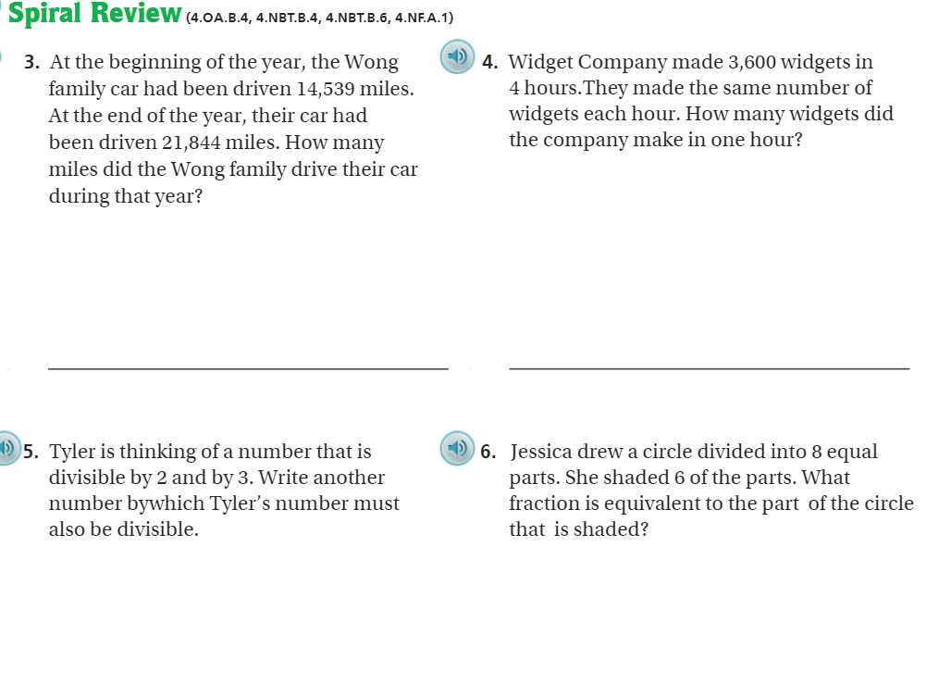
Page 356

Slide 10
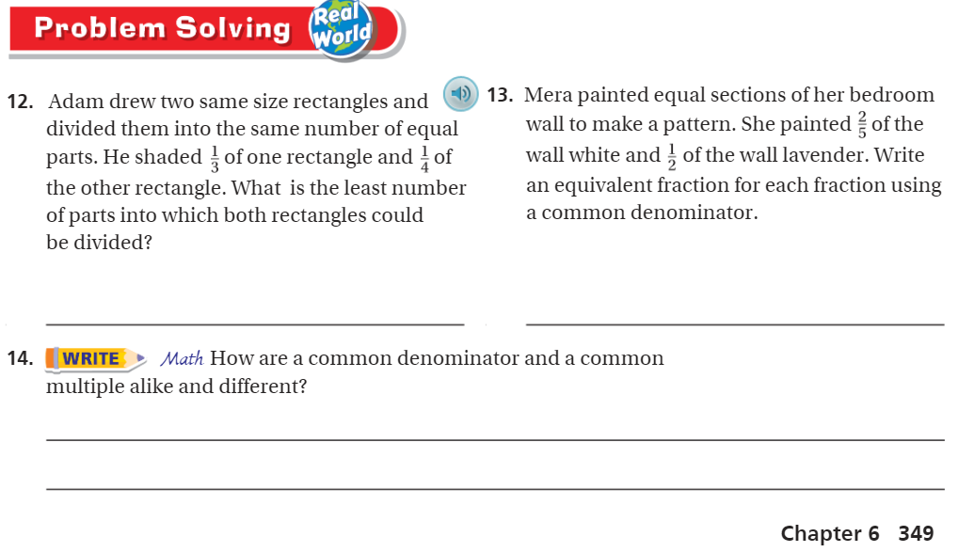
Page 349

Slide 11
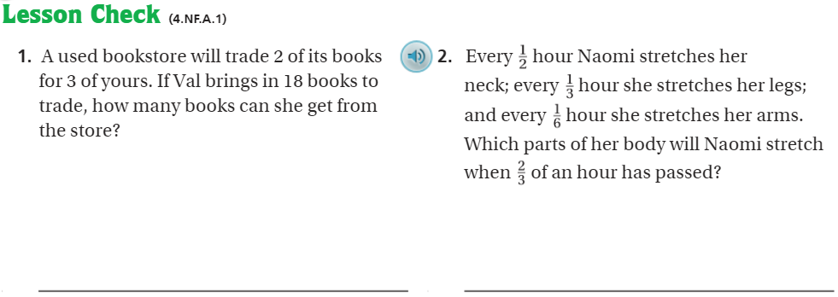
Page 356

Slide 12
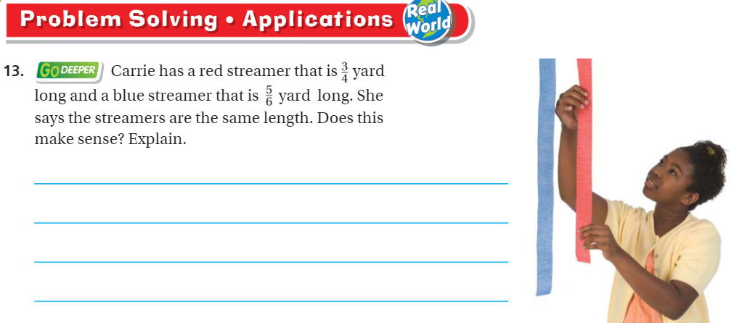
Page 348

Slide 13

The Friday Quiz – Pg.354

Slide 14
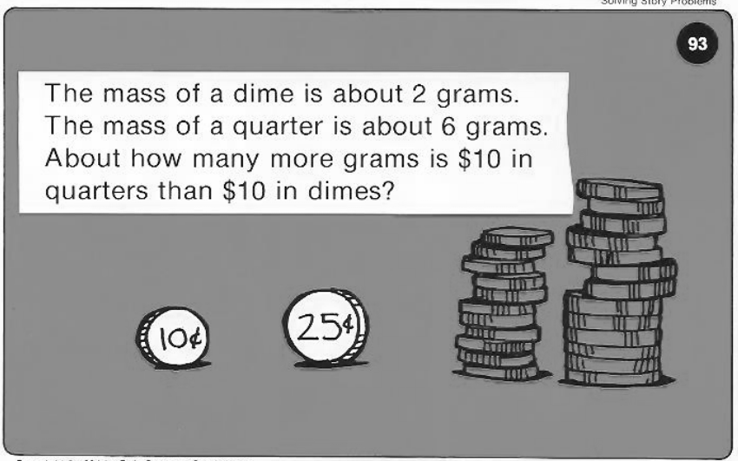
Calculator Problem

Slide 15
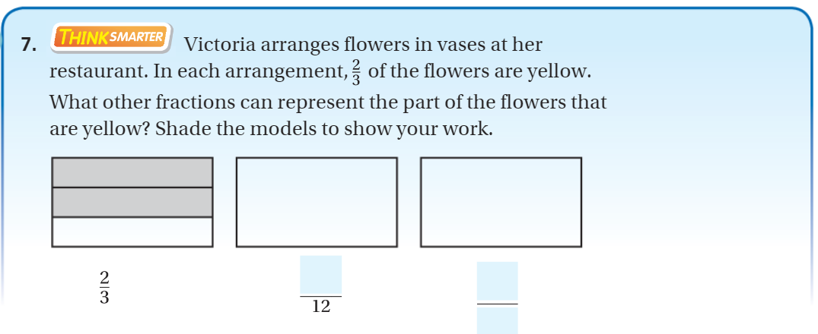
Exit Ticket – pg. 354

