Slide 1

Chapter 6
Lesson 6.5 Problem Solving

Slide 2
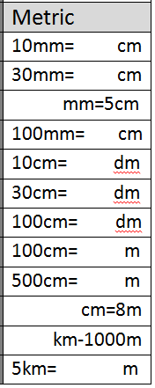
Fluency
Measurement

Slide 3
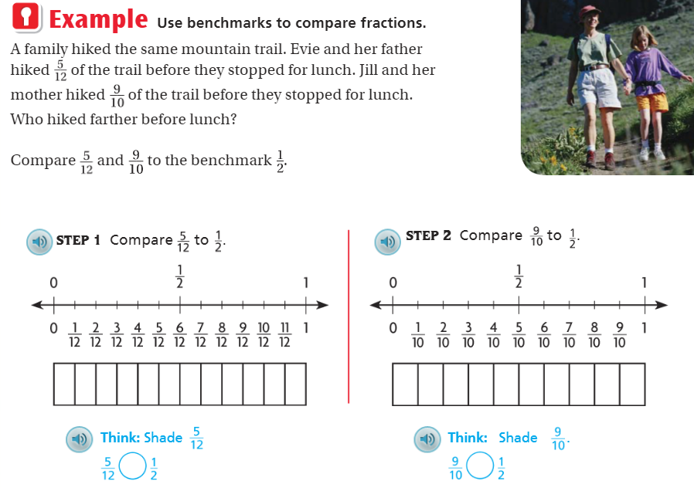
Teach and Reteach Pg.360

Slide 4
I can compare fractions using benchmarks
Will you be able to do this?
Yes! | Maybe | No

Slide 5
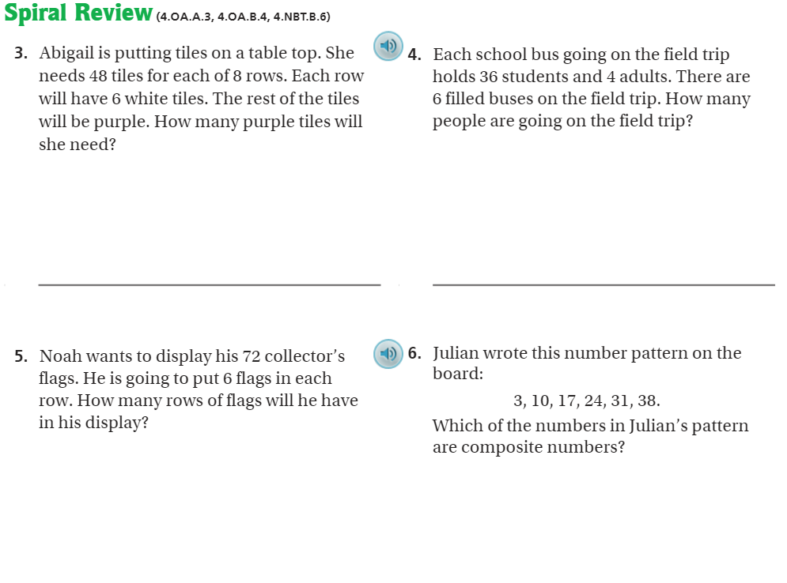
Page 364

Slide 6
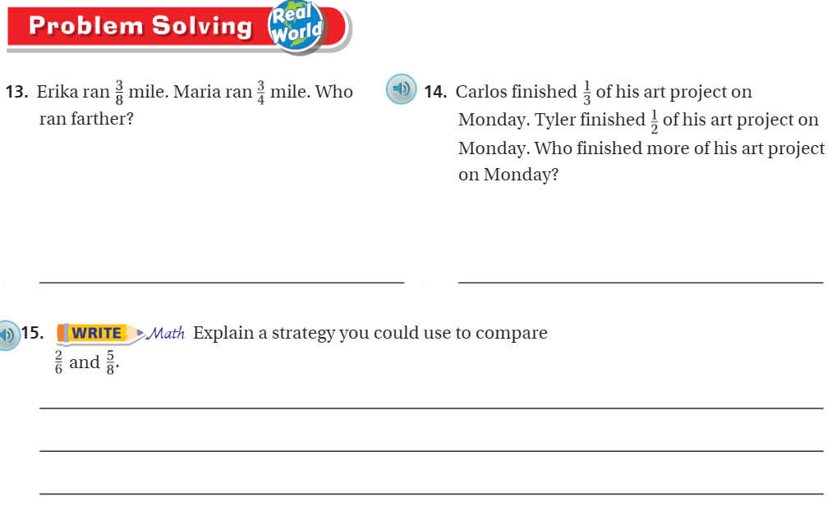
Pg. 363

Slide 7
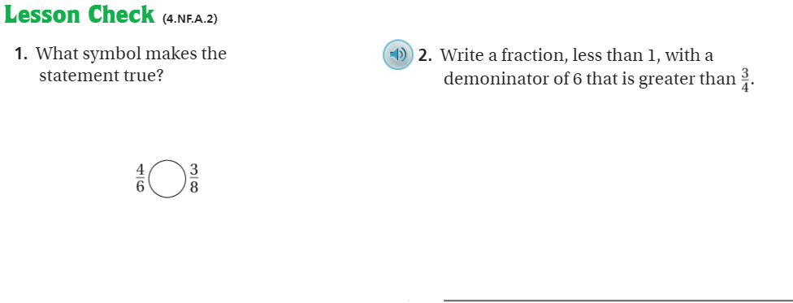
Pg. 364

Slide 8
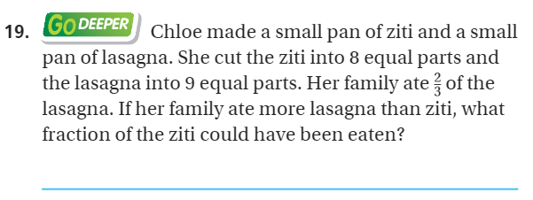
The Friday Quiz – Pg. 362

Slide 9
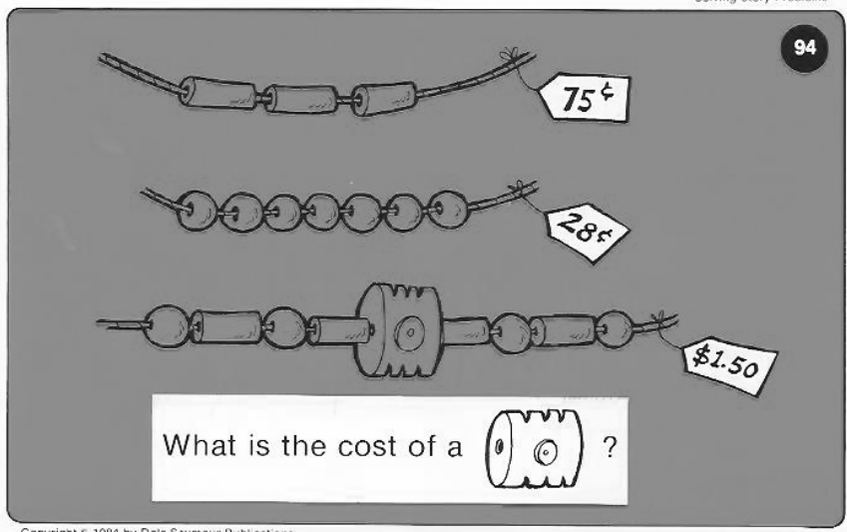
Calculator Problem

Slide 10
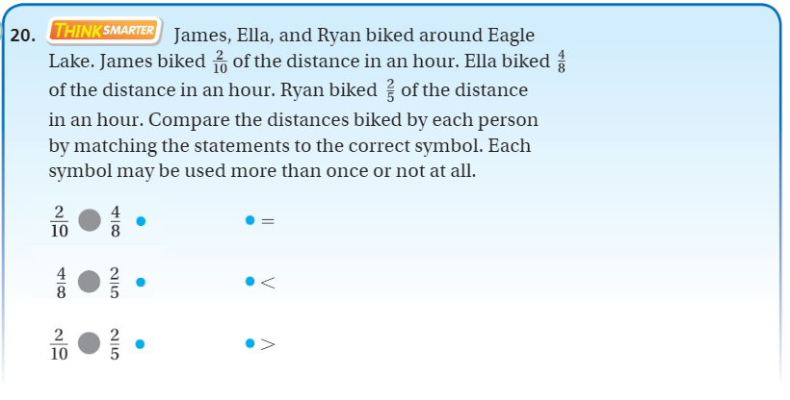
Exit Ticket – pg. 362

