Slide 1

Chapter 6
Lesson 6.7

Slide 2
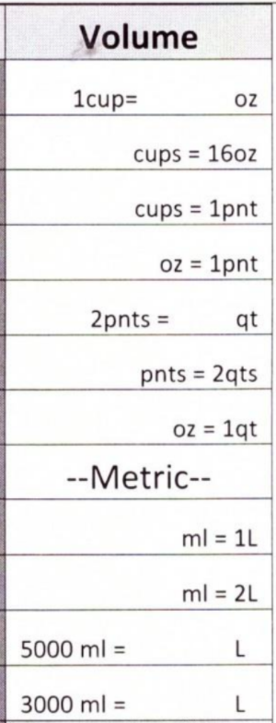
Fluency
Volume: The amount of space inside something

Slide 3
I can compare fractions using common denominators
Will you be able to do this?
Yes! | Maybe | No

Slide 4
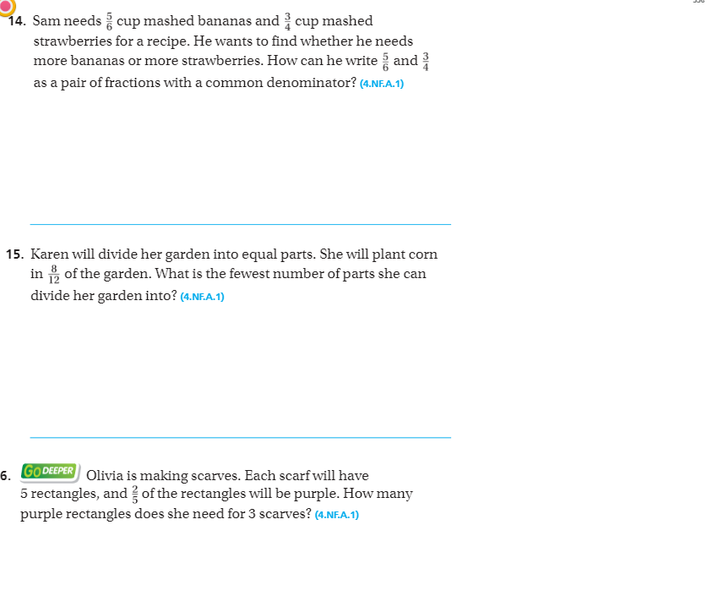
Page 358

Slide 5
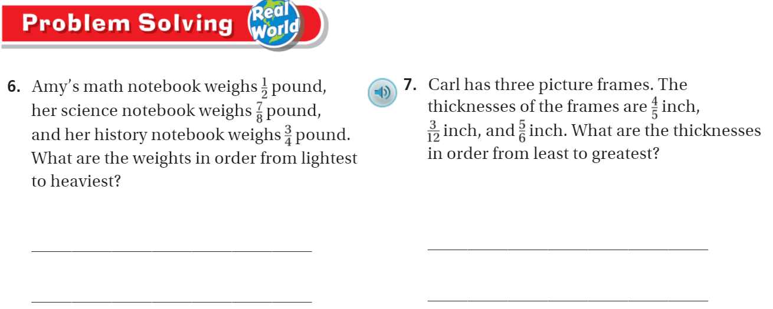
Page 375

Slide 6
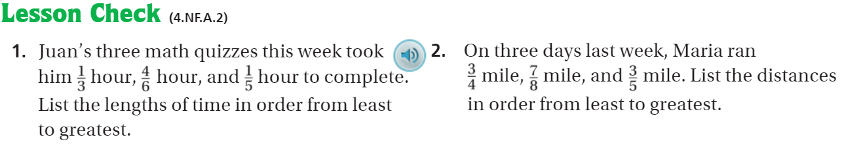
Pg. 376

Slide 7
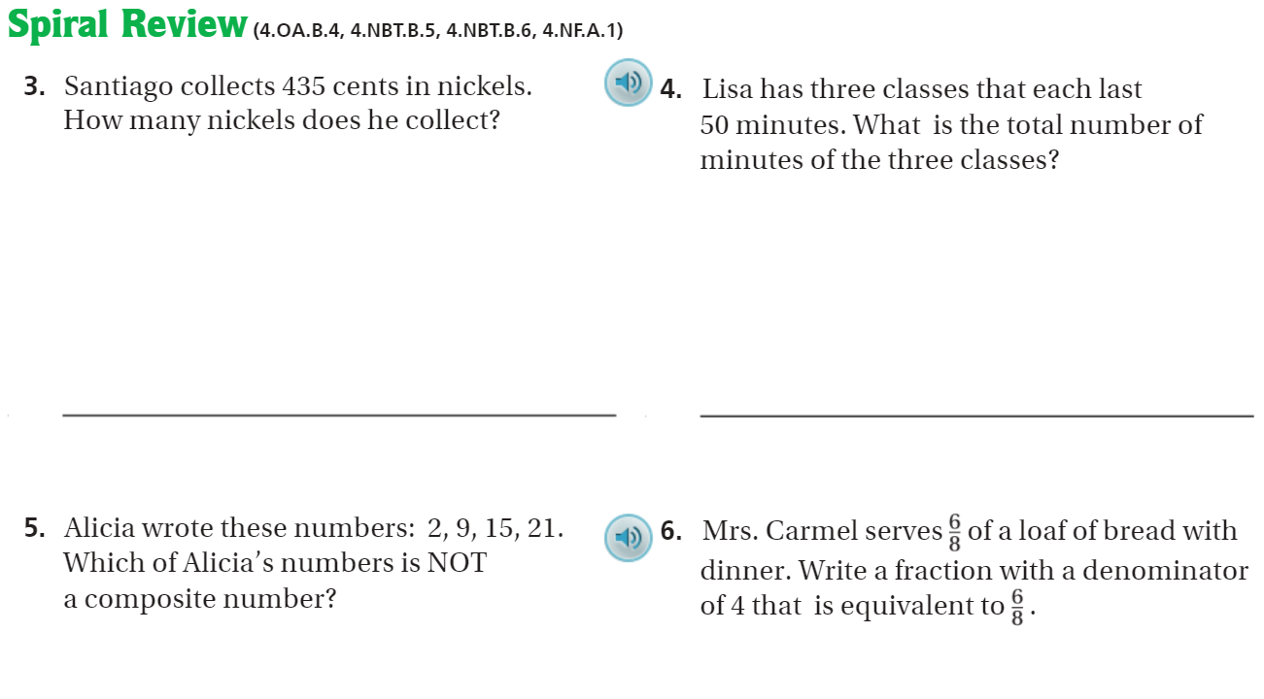
Page 376

Slide 8
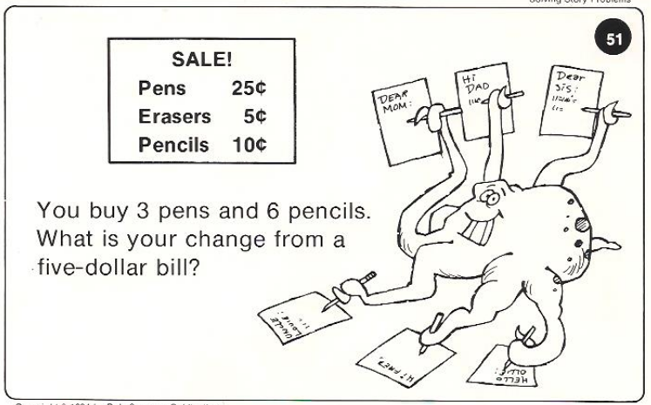
Calculator Problem

Slide 9
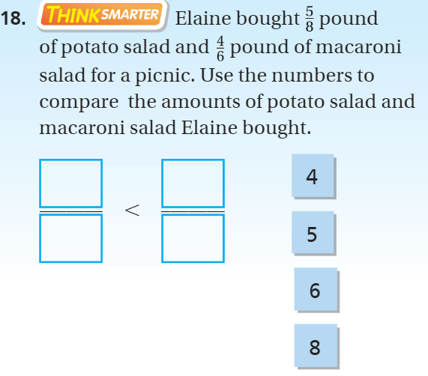
Exit Ticket – pg. 368

