Slide 1

Chapter 7
Lesson 7.1

Slide 2
From Earlier…
Make factor rainbows
18 | 24
2 | 51

Slide 3
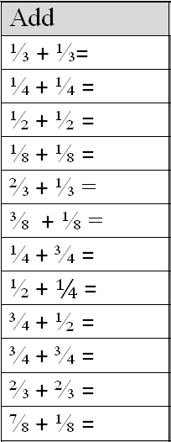
Fluency
Imagine the fraction strips

Slide 4
I can add and subtract fraction models
Will you be able to do this?
Yes! | Maybe | No

Slide 5
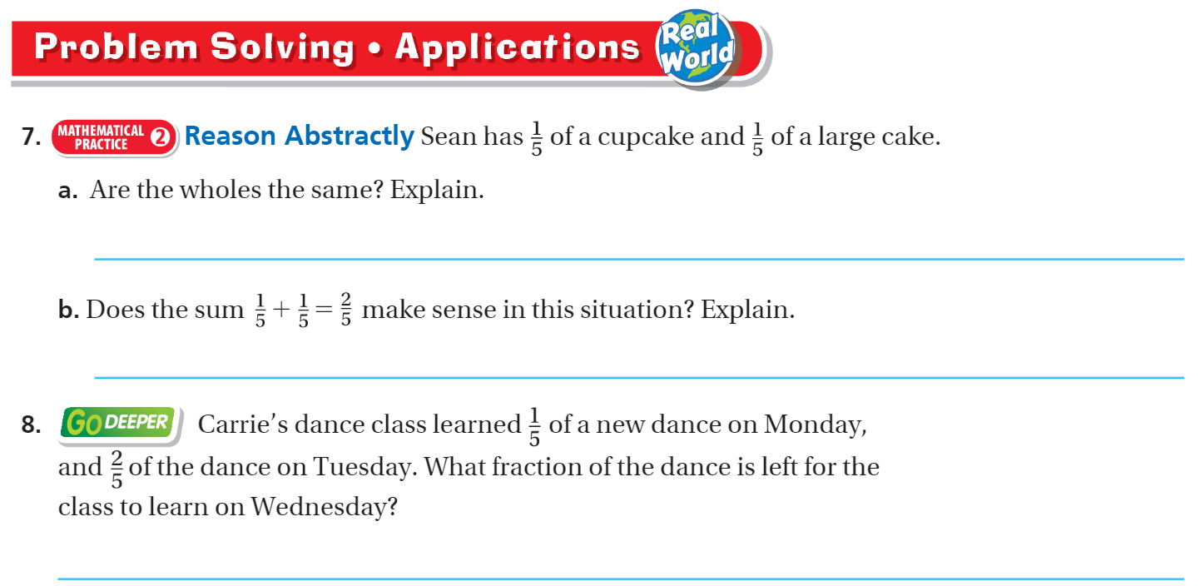
Page 387

Slide 6
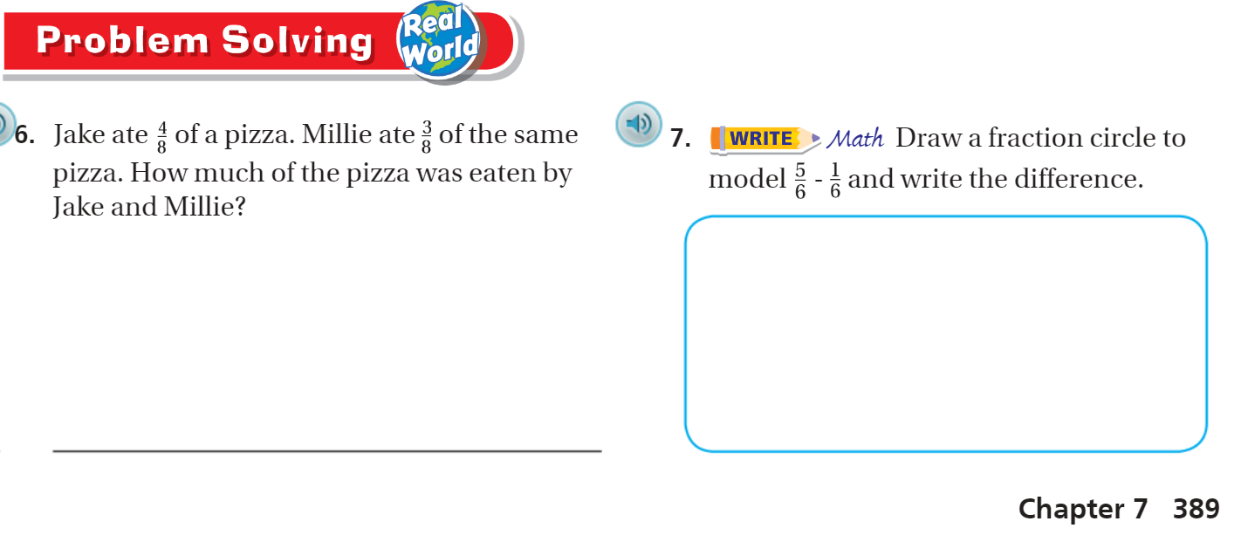
Page 389

Slide 7
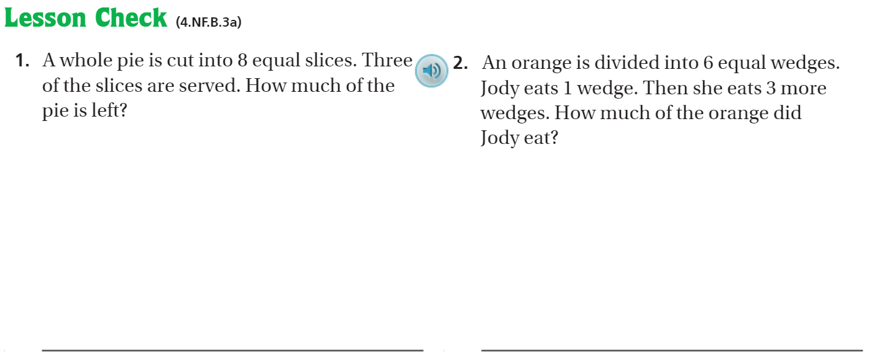
Page 390

Slide 8
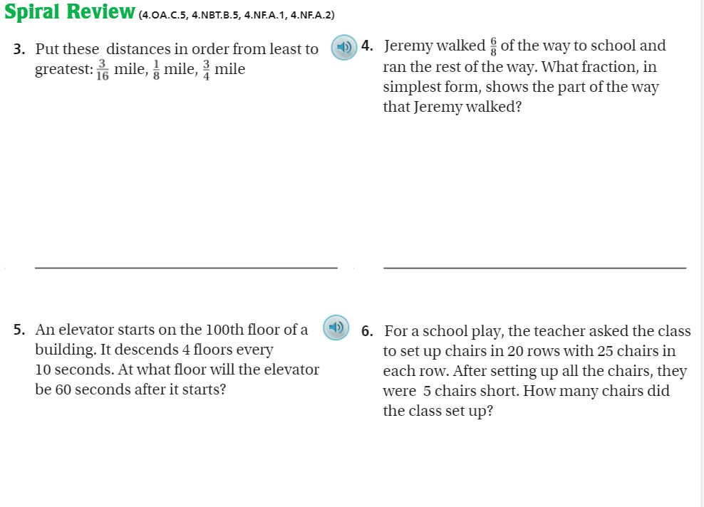
Page 390

Slide 9
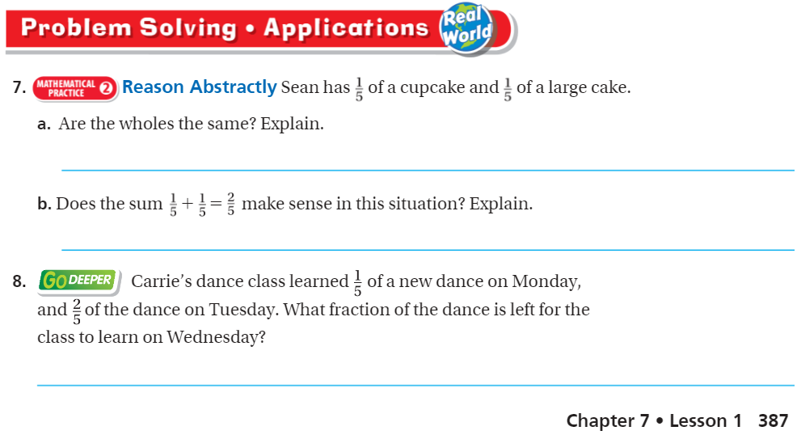
Page 387

Slide 10
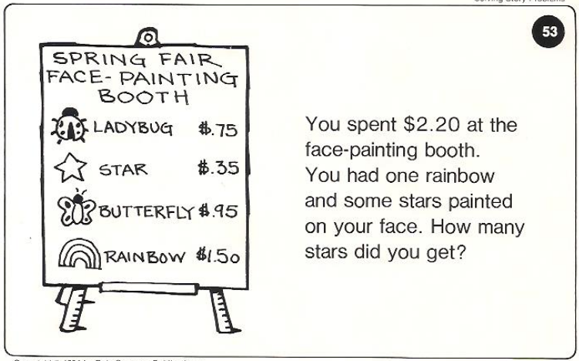
Calculator Problem

Slide 11
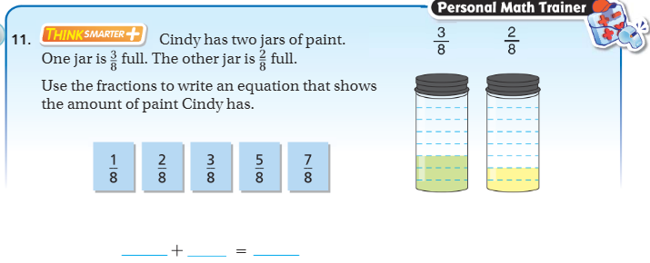
Exit Ticket – pg. 374

