Slide 1

Chapter 7
Lesson 7.5 Problem Solving

Slide 2
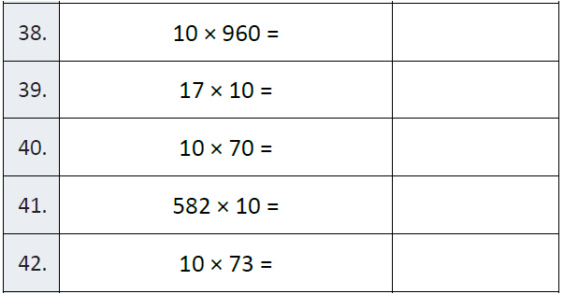
Fluency

Slide 3
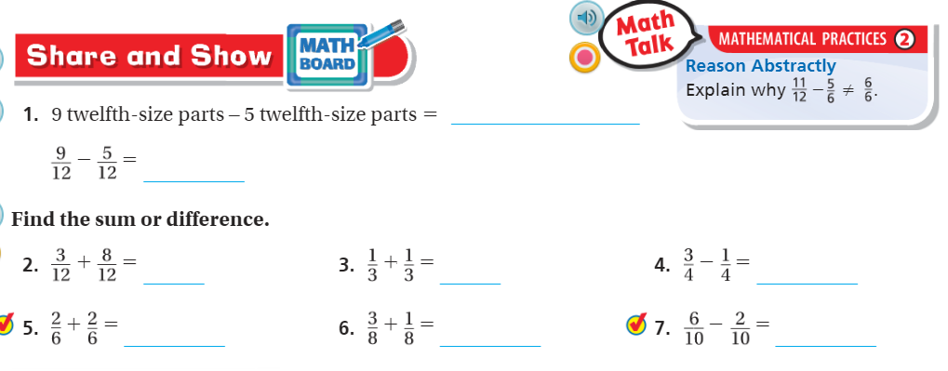
Teach and Reteach Pg.410

Slide 4
I can add and subtract fractions
Will you be able to do this?
Yes! | Maybe | No

Slide 5
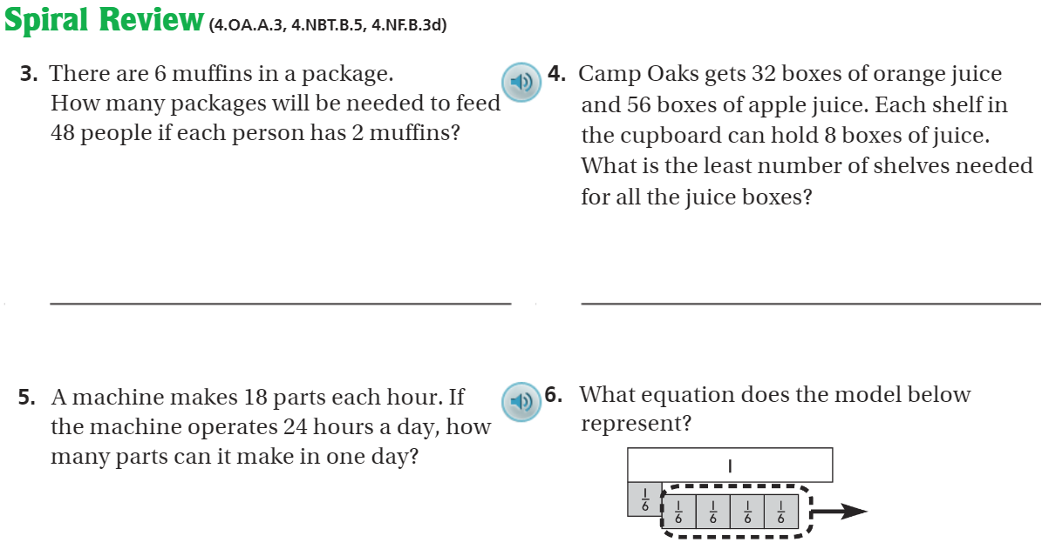
Page 414

Slide 6
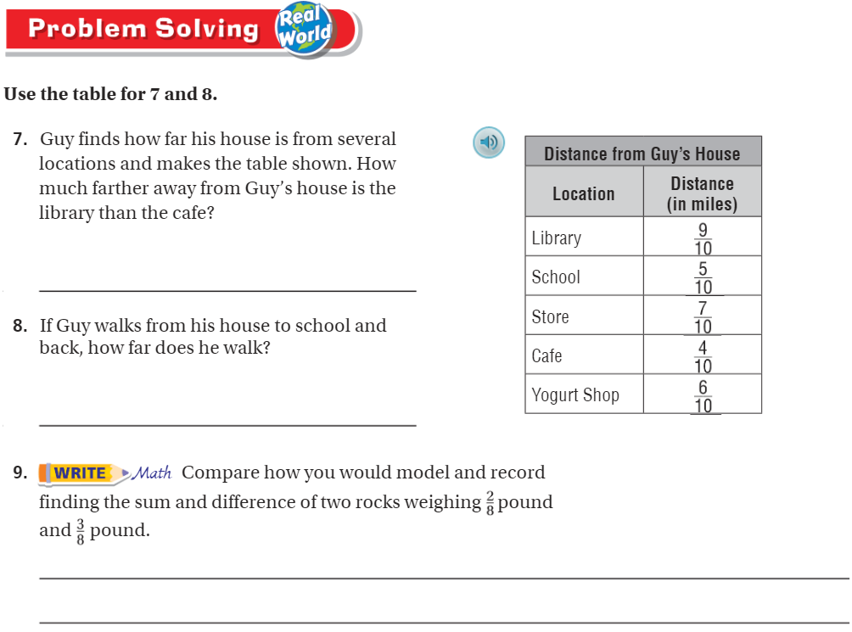
Pg.413

Slide 7
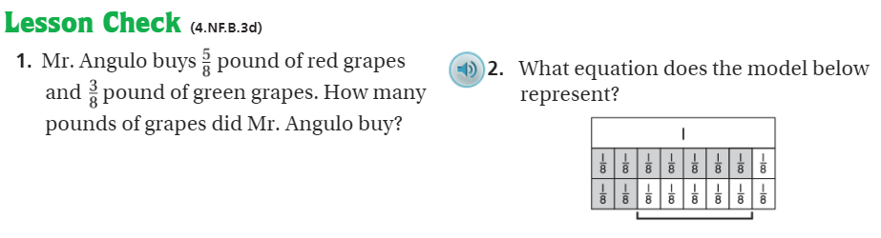
Pg. 414

Slide 8
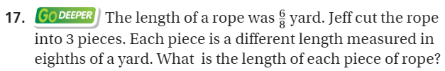
The Friday Quiz – Pg. 411

Slide 9
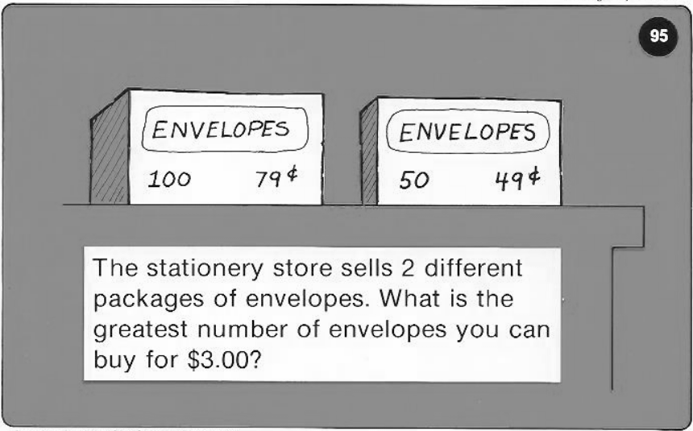
Calculator Problem

Slide 10
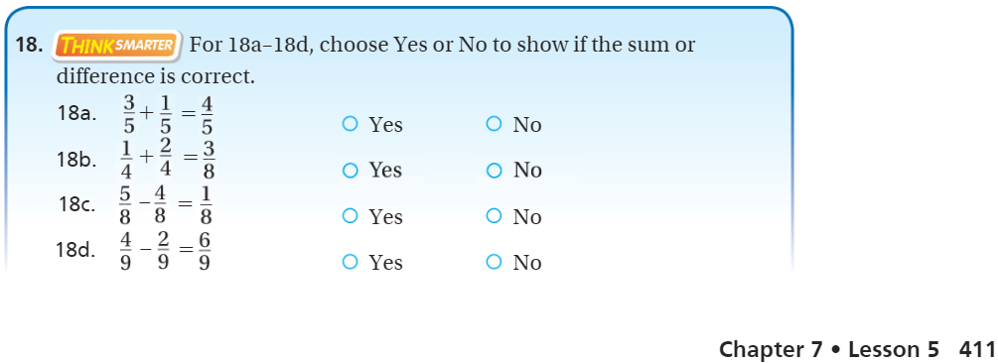
Exit Ticket – pg.411

