Slide 1

Chapter 7
Lesson 7.7 & 7.8 Problem Solving

Slide 2
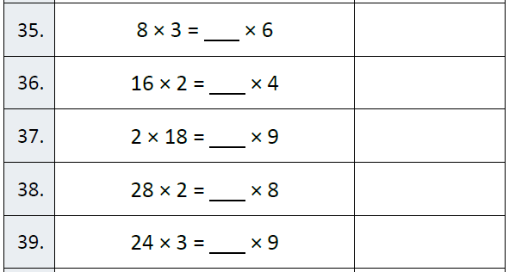
Fluency

Slide 3
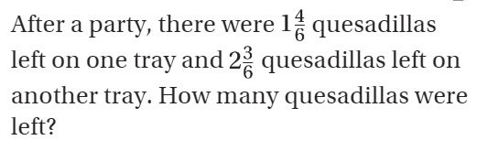


Teach and Reteach - Pg. 423

Slide 4
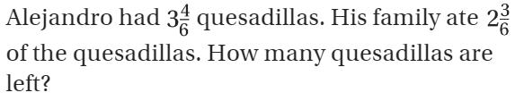
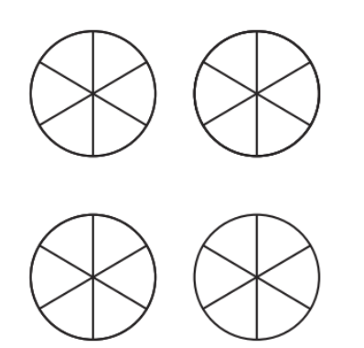
Teach and Reteach - Pg.424

Slide 5
I can add and subtract mixed numbers
Will you be able to do this?
Yes! | Maybe | No

Slide 6
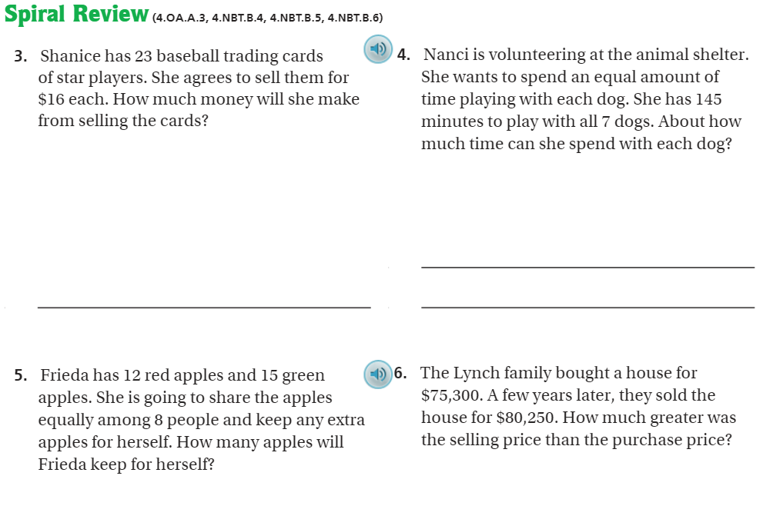
Pg. 428

Slide 7
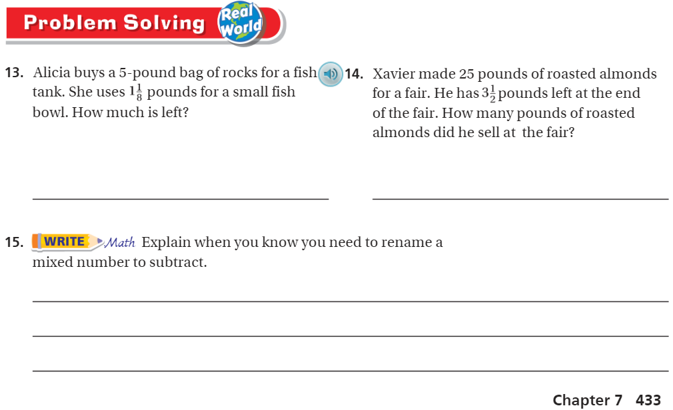
pg. 433

Slide 8
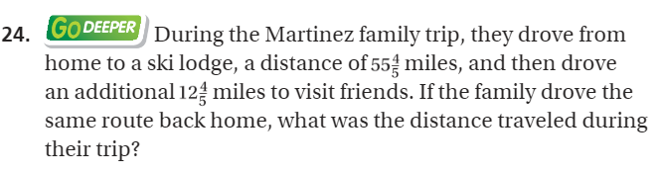
The Friday Quiz – Pg. 426

Slide 9
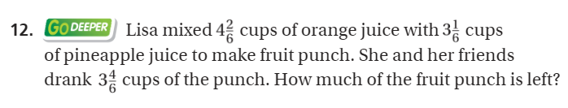
The Friday Quiz – Pg. 431

Slide 10
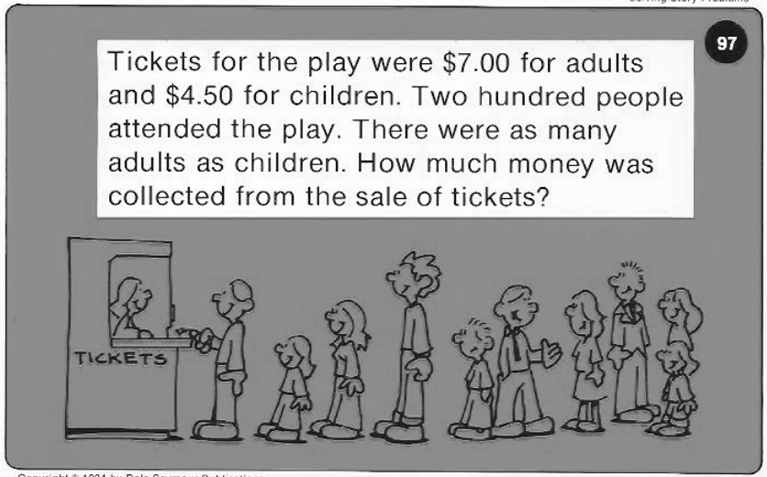
Calculator Problem

Slide 11
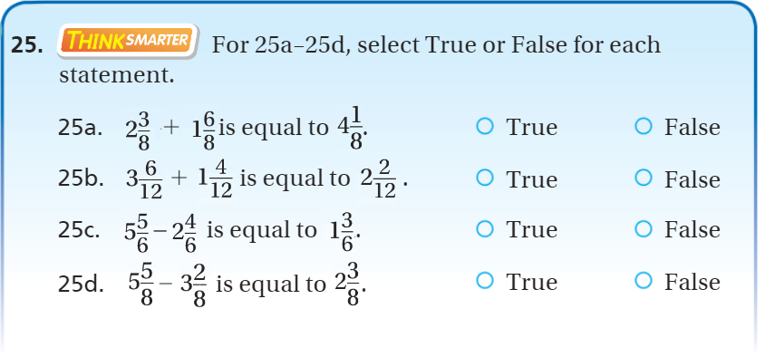
Exit Ticket – pg.426

