Slide 1

Chapter 7
Lesson 7.8

Slide 2
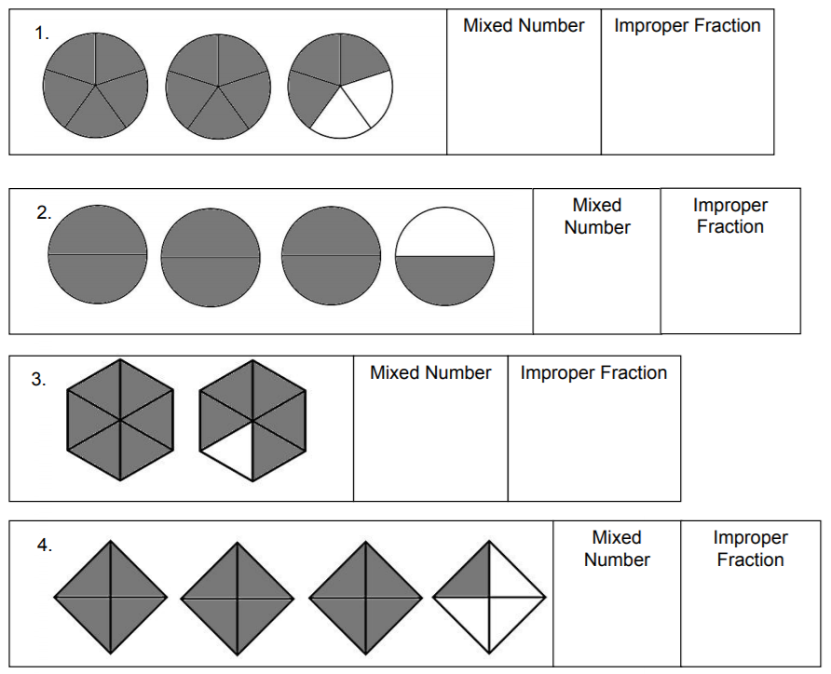
Let’s Look Back

Slide 3
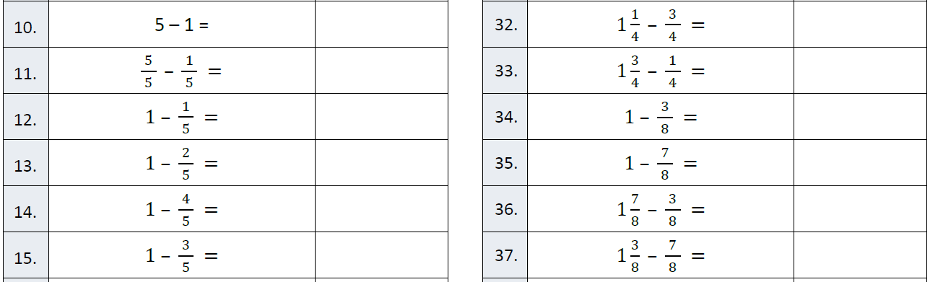
Fluency

Slide 4
I can add and subtract mixed numbers with renaming
Will you be able to do this?
Yes! | Maybe | No

Slide 5
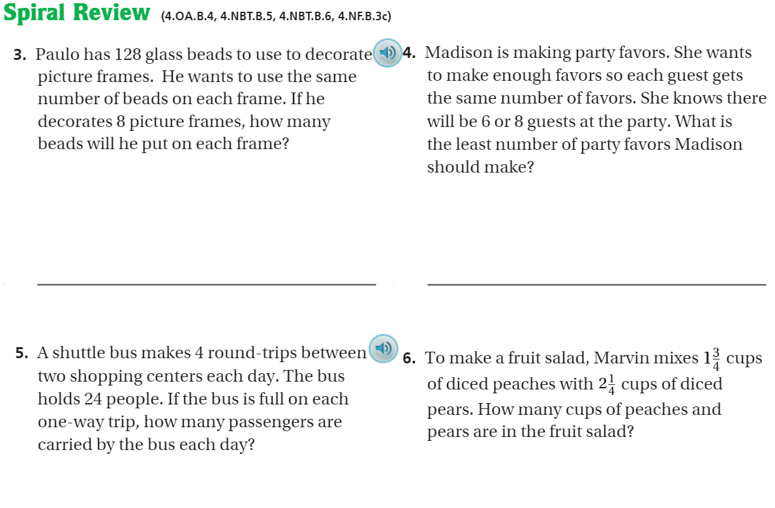
Pg. 434

Slide 6
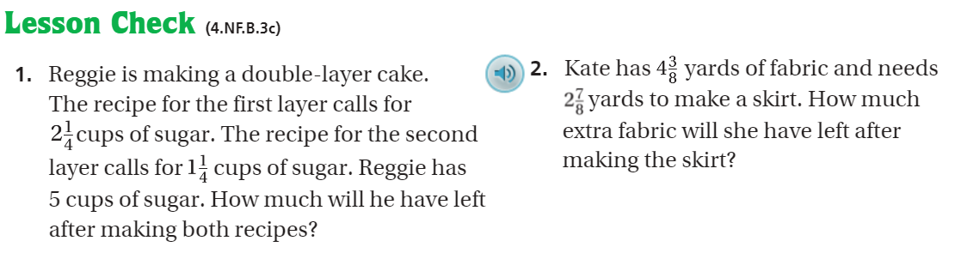
Pg. 434

Slide 7
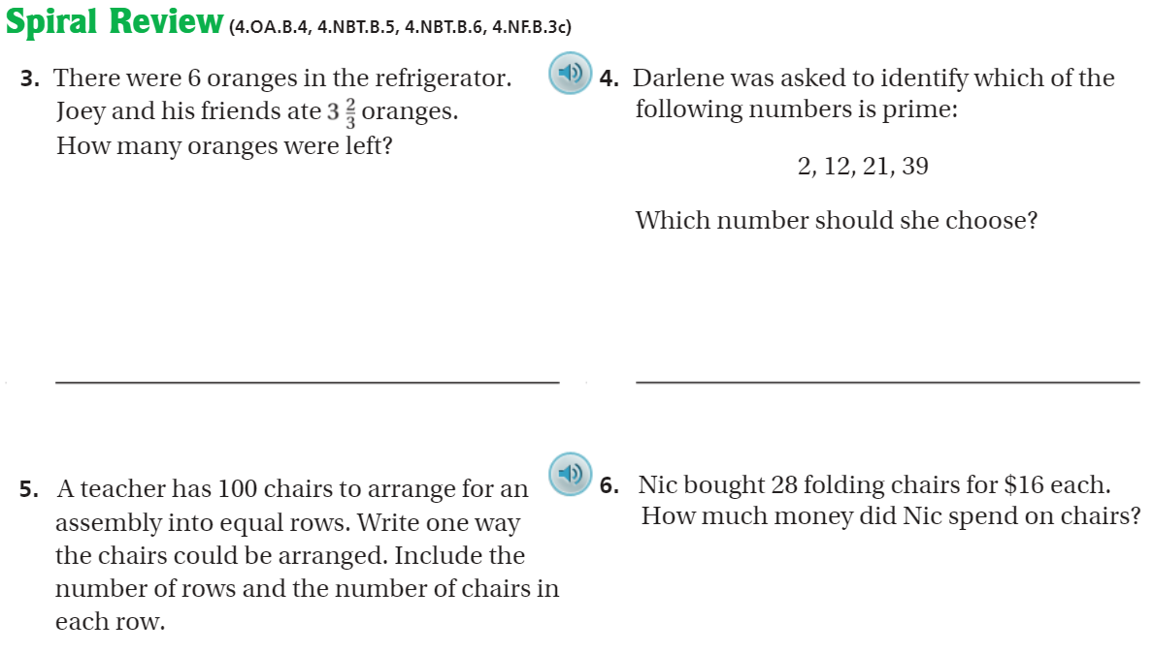
Pg. 440

Slide 8
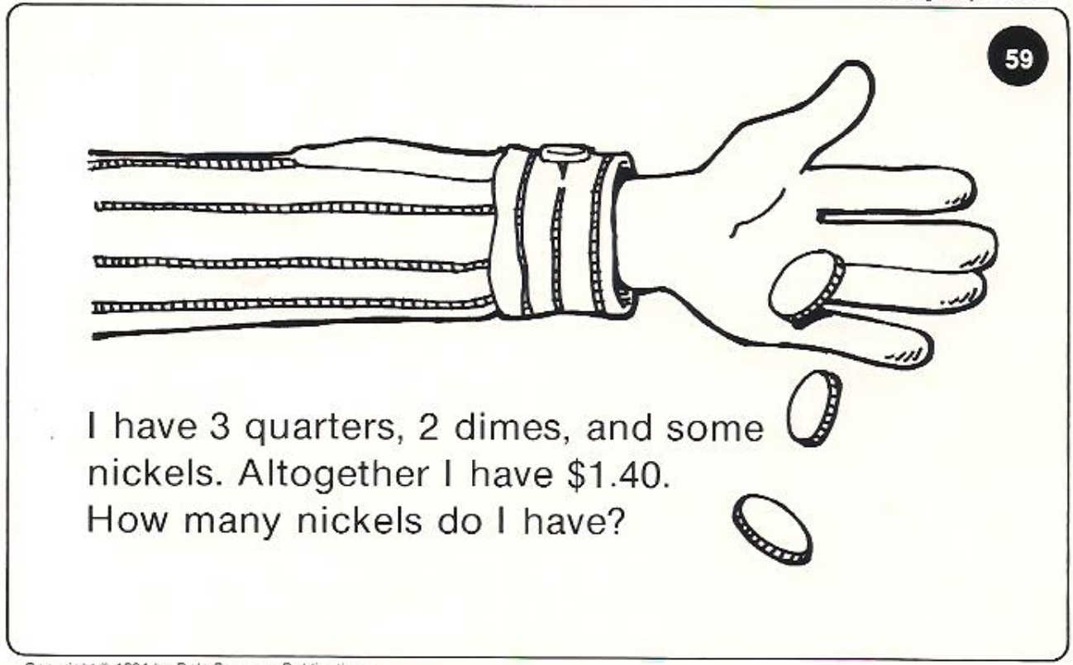
Calculator Problem

Slide 9
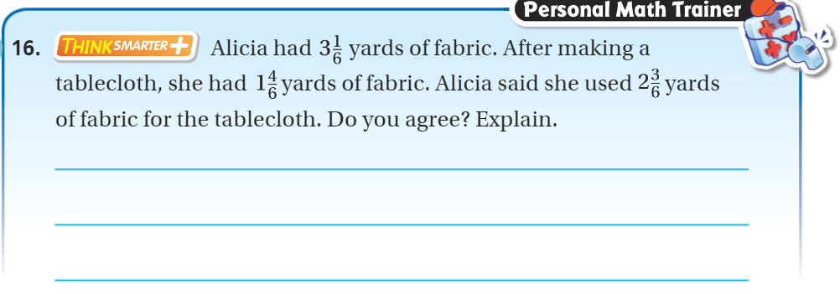
Exit Ticket – pg.432

