Slide 1

Chapter 7
Lesson 7.6 Problem Solving

Slide 2
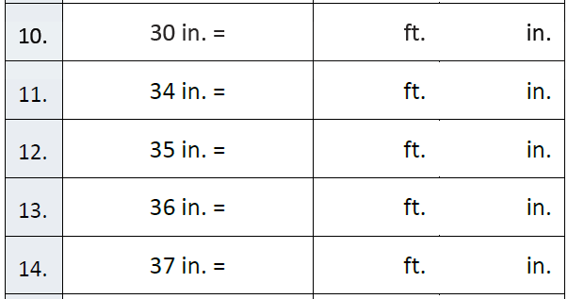
Fluency

Slide 3
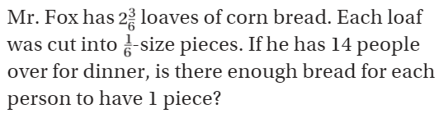
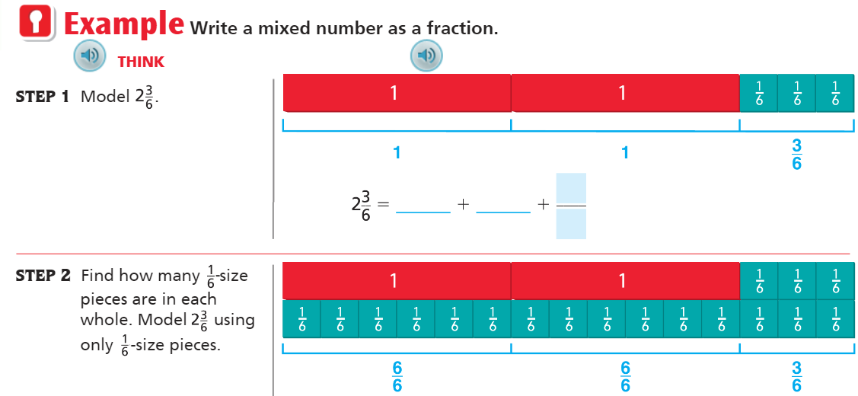
Teach and Reteach - Pg. 417

Slide 4
I can show improper fractions and mixed numbers
Will you be able to do this?
Yes! | Maybe | No

Slide 5
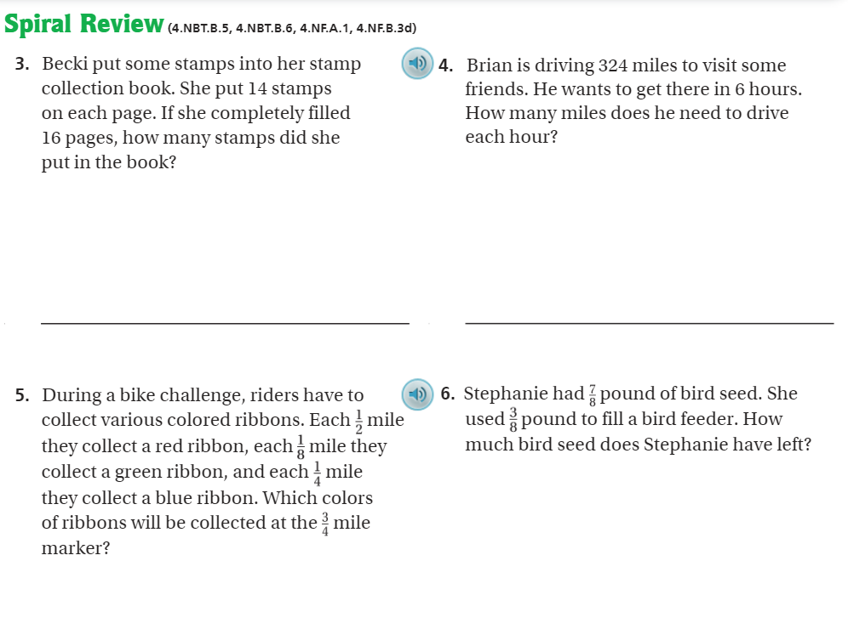
Pg. 422

Slide 6
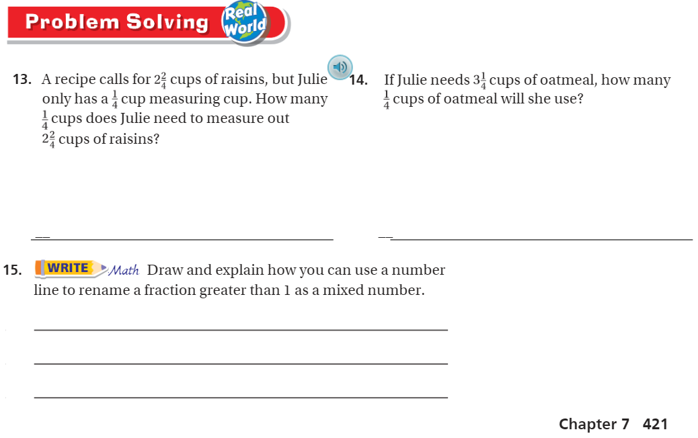
pg. 421

Slide 7
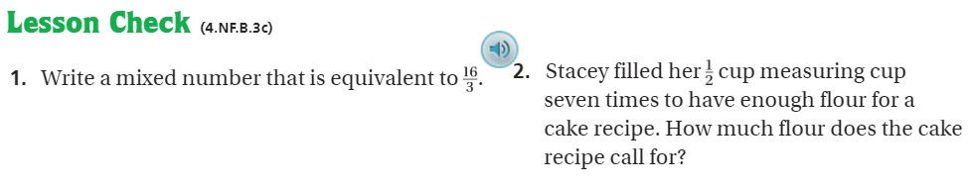
Pg. 422

Slide 8
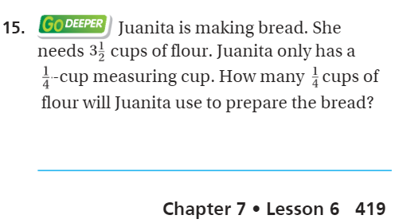
The Friday Quiz – Pg. 419

Slide 9
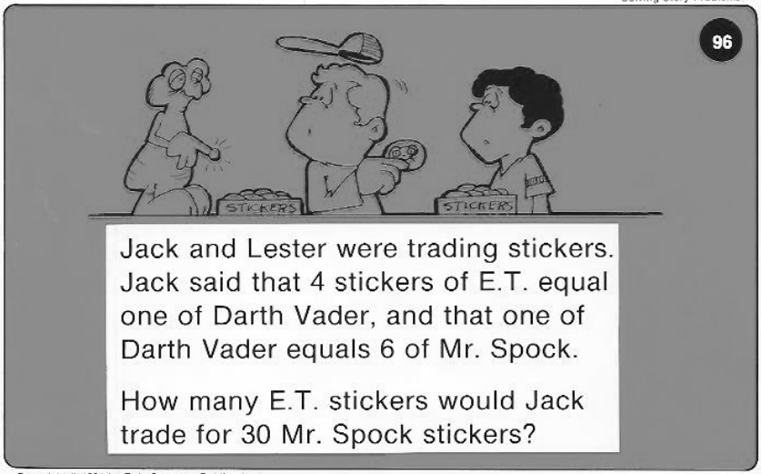
Calculator Problem

Slide 10
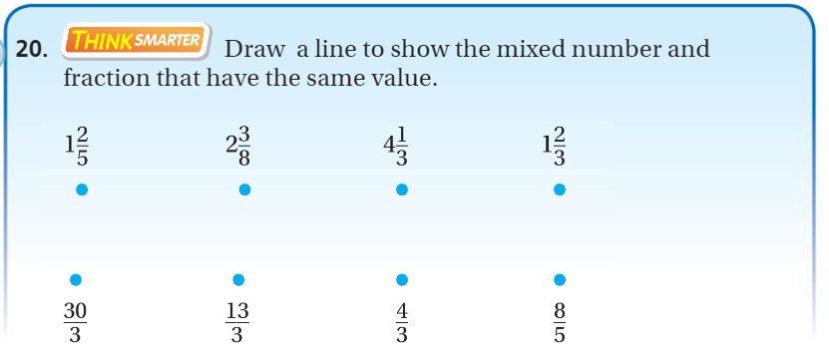
Exit Ticket – pg.420

