Slide 1

First Quarter Review

Slide 2
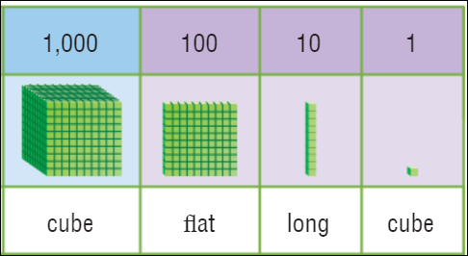
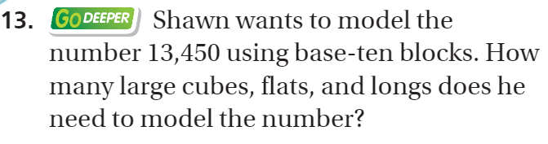
Chapter 1 – Pg. 7

Slide 3
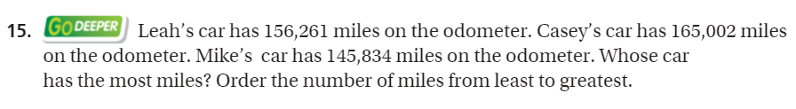
Chapter 1 – Pg. 19

Slide 4
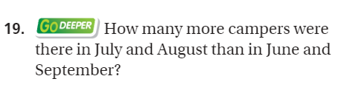
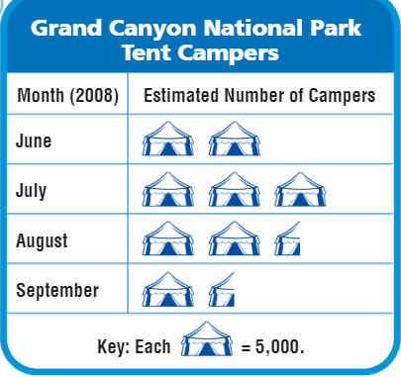
Chapter 1 – Pg. 20

Slide 5
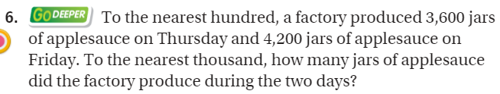
Chapter 1 – Pg. 25

Slide 6
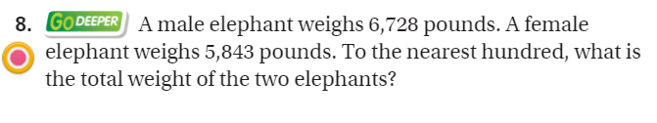
Chapter 1 – Pg. 26

Slide 7
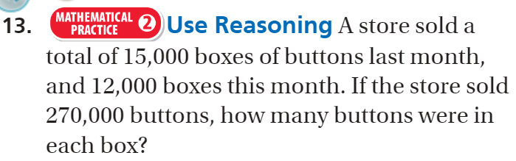
Chapter 1 – Pg. 34

Slide 8
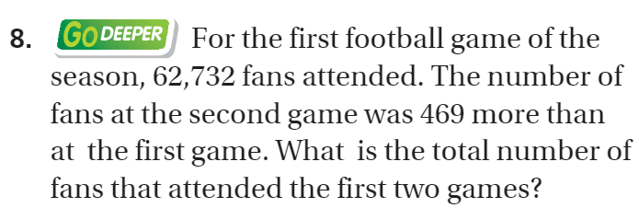
Chapter 1 – Pg. 39

Slide 9
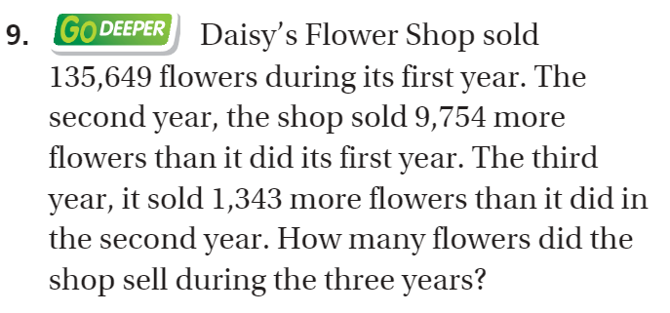
Chapter 1 – Pg. 39

Slide 10

Chapter 1 – Pg. 40

Slide 11
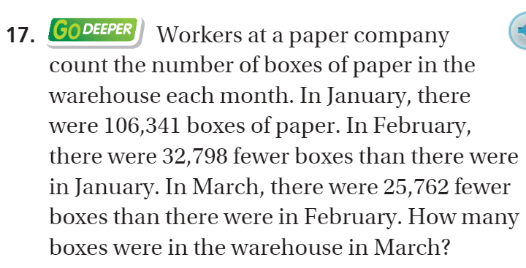
Chapter 1 – Pg. 45

Slide 12

Chapter 2 – Pg. 71

Slide 13
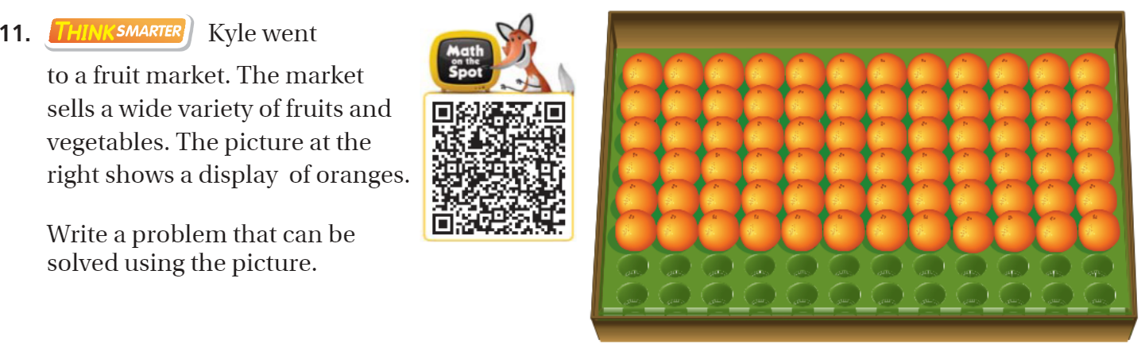
Chapter 2 – Pg. 90

Slide 14
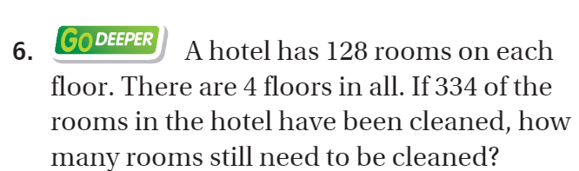
Chapter 2 – Pg. 95

Slide 15
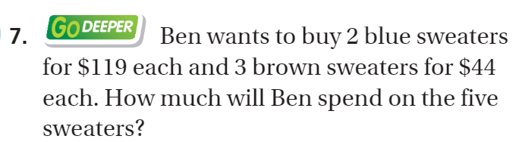
Chapter 2 – Pg. 95

Slide 16
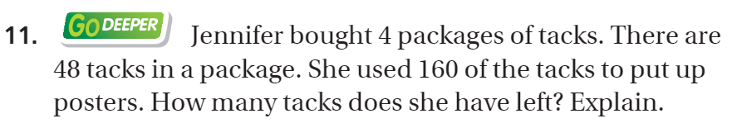
Chapter 2 – Pg. 95

Slide 17
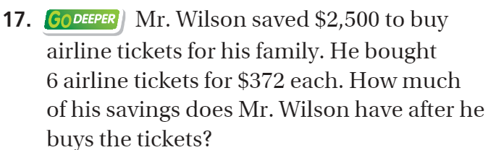
Chapter 2 – Pg. 101

Slide 18
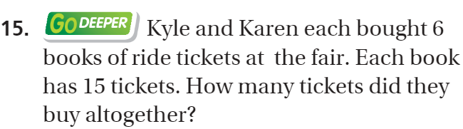
Chapter 2 – Pg. 109

Slide 19
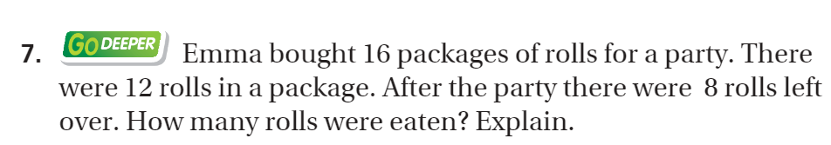
Chapter 3 – Pg. 159

Slide 20
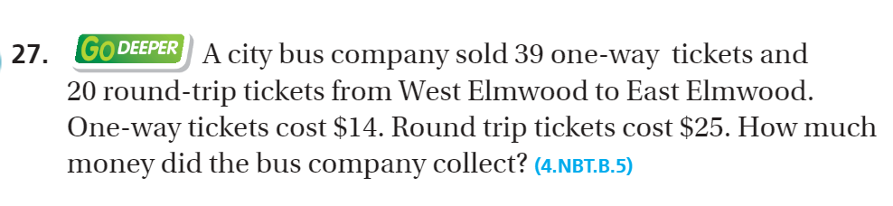
Chapter 3 – Pg. 170

Slide 21
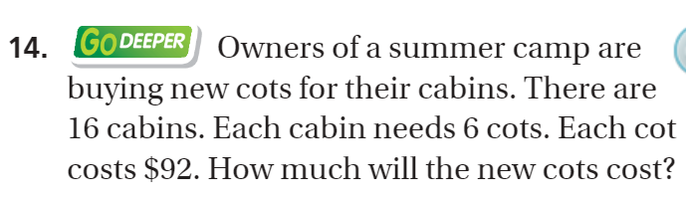
Chapter 3 - pg. 173

Slide 22
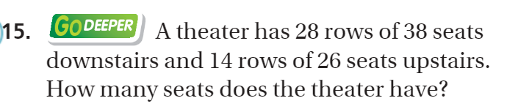
Chapter 3 – Pg. 173

Slide 23
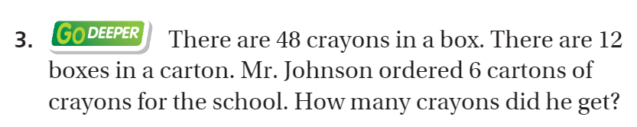
Chapter 3 – Pg. 185

