Slide 1

Chapter 7
Lesson 7.9

Slide 2
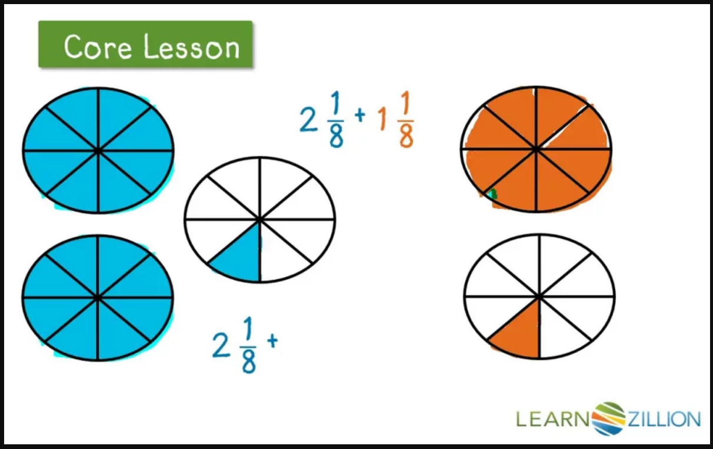

Slide 3
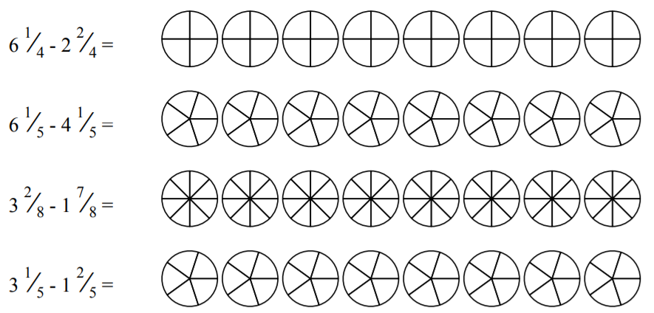

Slide 4
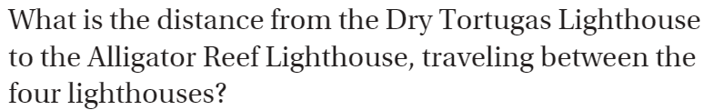
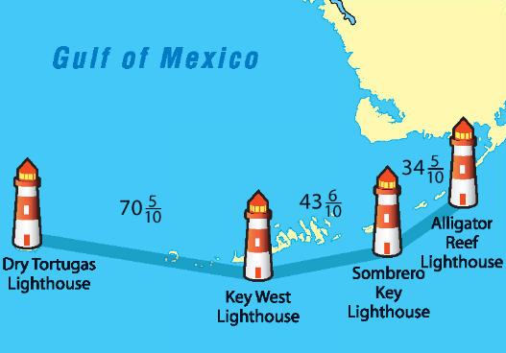

Slide 5
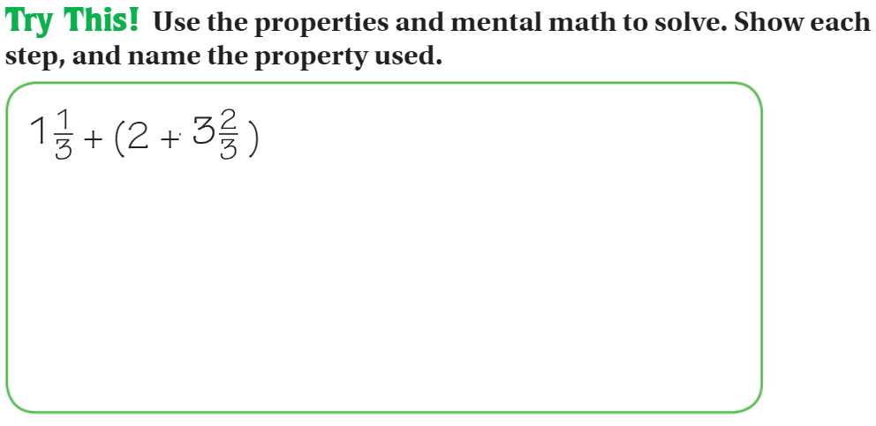

Slide 6


Slide 7
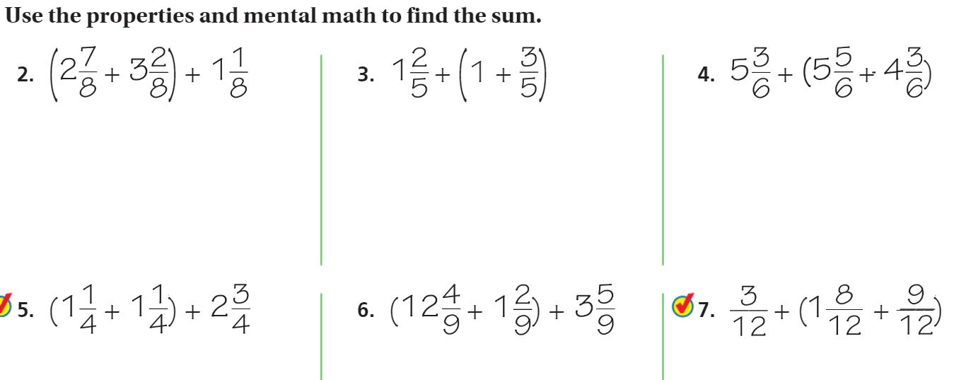
Which should you add first?

Slide 8
I can add and subtract mixed numbers with renaming
Will you be able to do this?
Yes! | Maybe | No

Slide 9
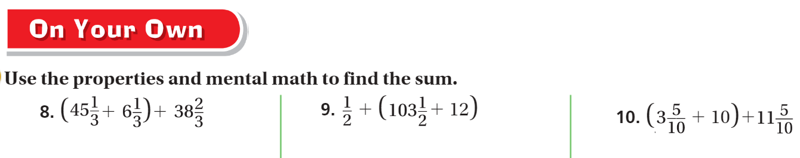
Pg. 437

Slide 10
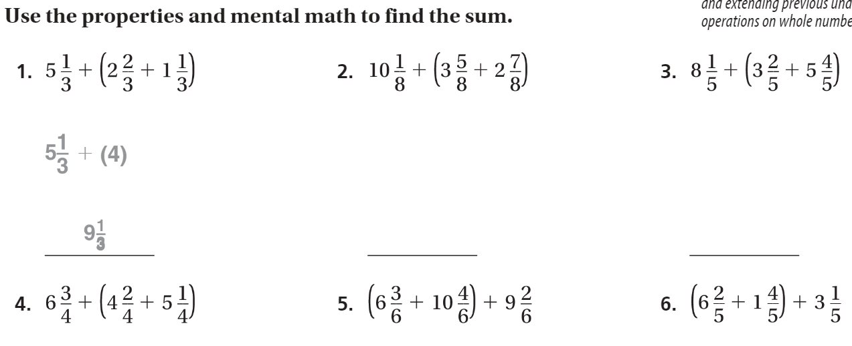
Friday Quiz pg. 439

Slide 11
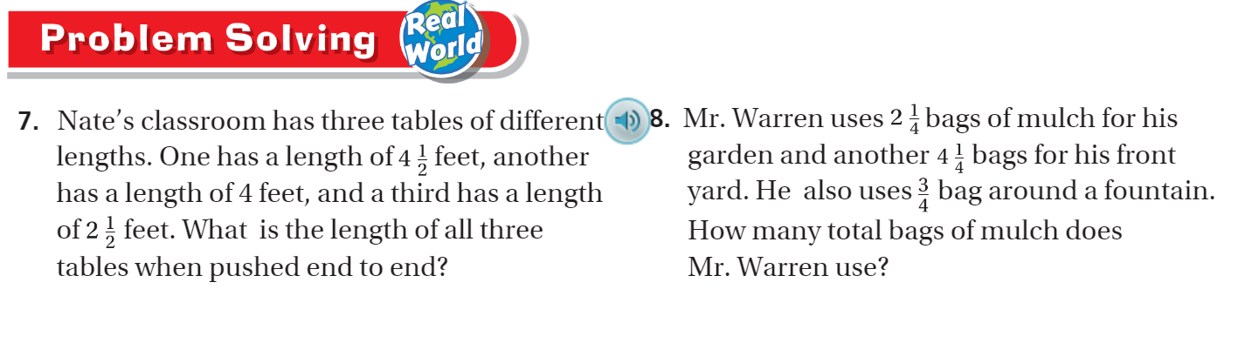
Pg. 439

