Slide 1

Chapter 13
Lesson 13.1 & 13.2 Problem Solving

Slide 2
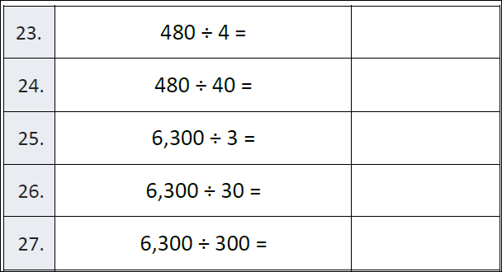

Slide 3
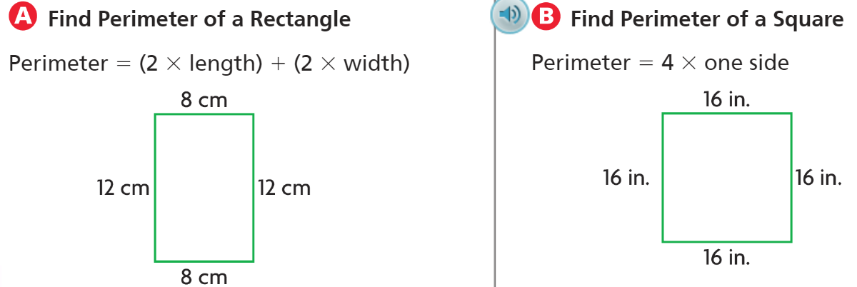
Teach and Reteach – pg. 717

Slide 4
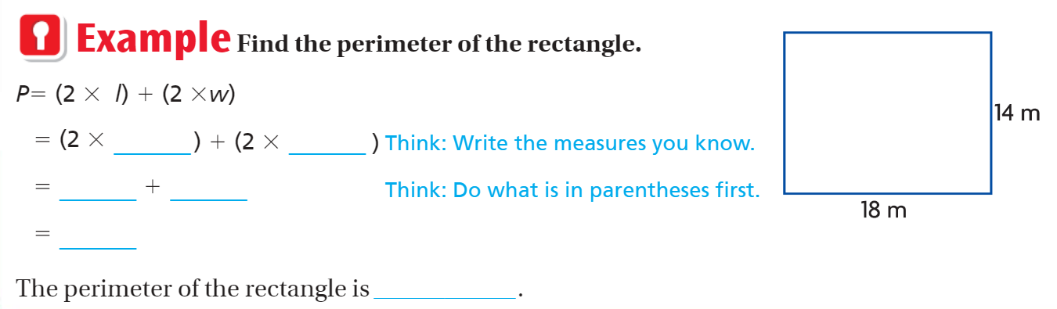
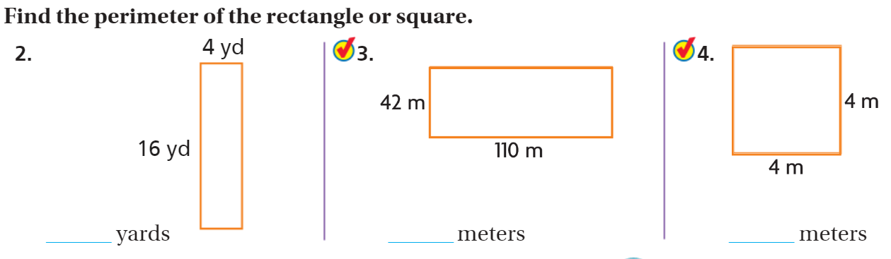

Slide 5
I can find the perimeter.
Will you be able to do this?
Yes! | Maybe | No

Slide 6
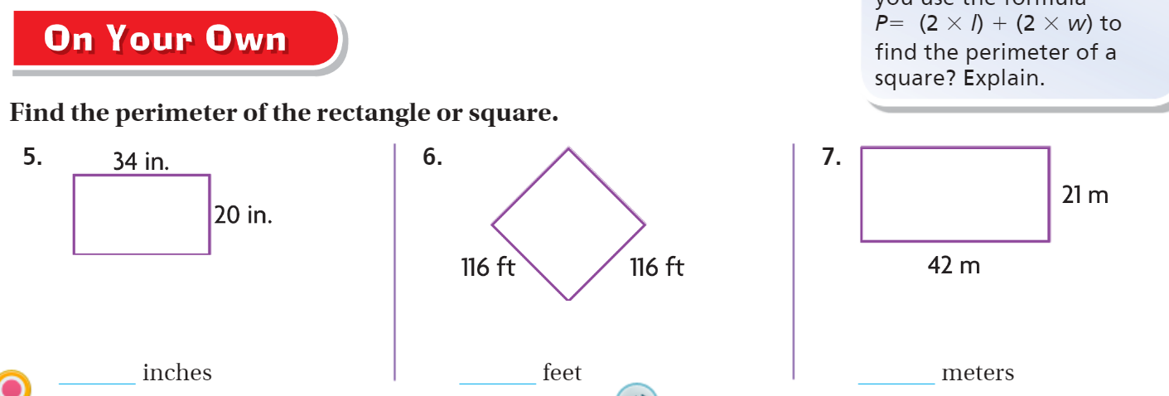
Pg. 719

Slide 7
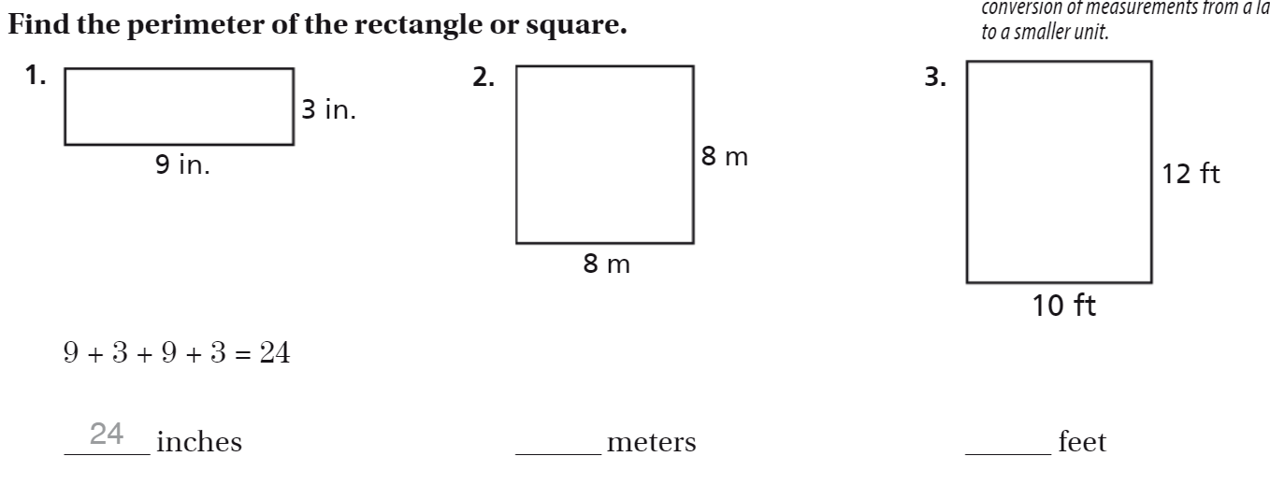
Pg. 721

Slide 8
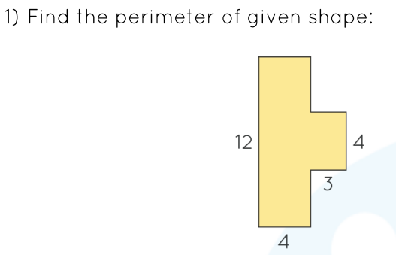
Irregular Shapes - Challenge

Slide 9
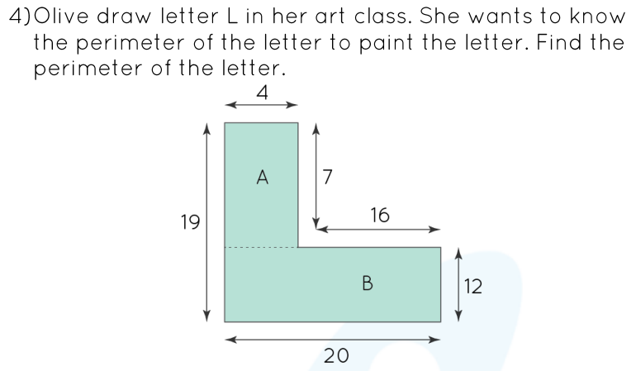
Irregular Shapes - Challenge

Slide 10
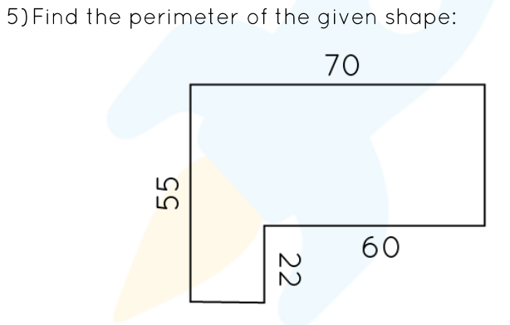
Irregular Shapes - Challenge

Slide 11
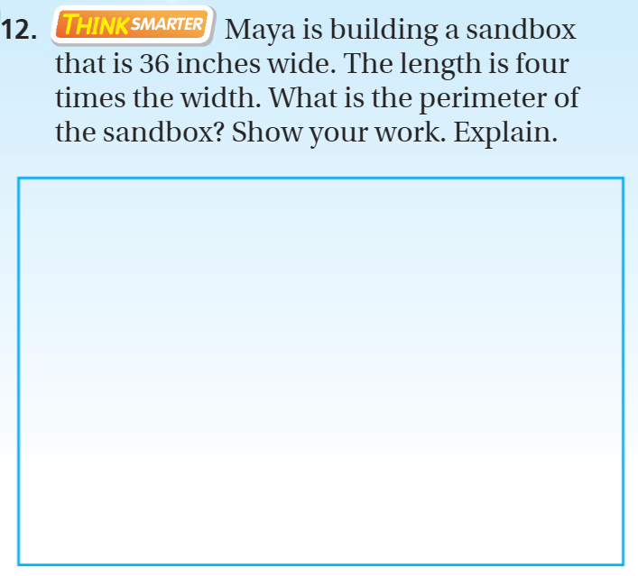
Exit Ticket – pg. 720

