Slide 1
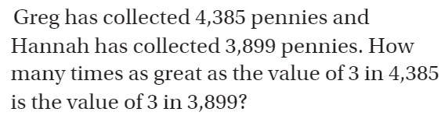
Chapter 1 Review

Slide 2

Chapter 1 Review

Slide 3
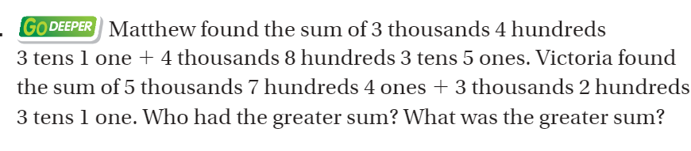
Chapter 1 Review

Slide 4
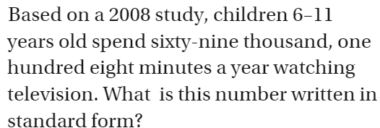
Chapter 1 Review

Slide 5

Chapter 1 Review

Slide 6

Chapter 1 Review

Slide 7
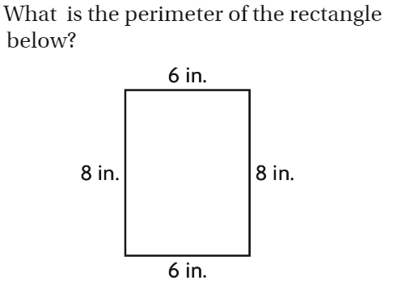
Chapter 1 Review

Slide 8

Chapter 1 Review

Slide 9

Chapter 2 Review

Slide 10
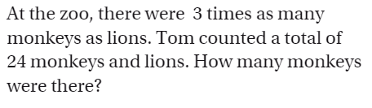
Chapter 2 Review

Slide 11

Chapter 2 Review

Slide 12

Chapter 2 Review

Slide 13
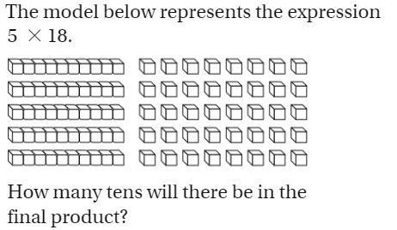
Chapter 2 Review

Slide 14
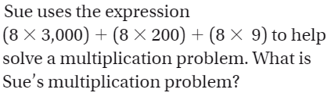
Chapter 2 Review

Slide 15
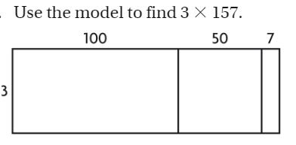
Chapter 2 Review

Slide 16
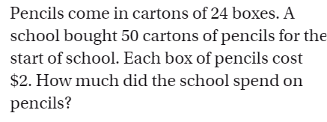
Chapter 2 Review

Slide 17
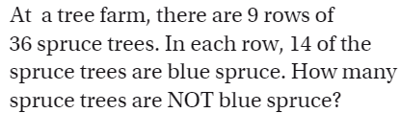
Chapter 2 Review

Slide 18

Chapter 2 Review

